Slide 1
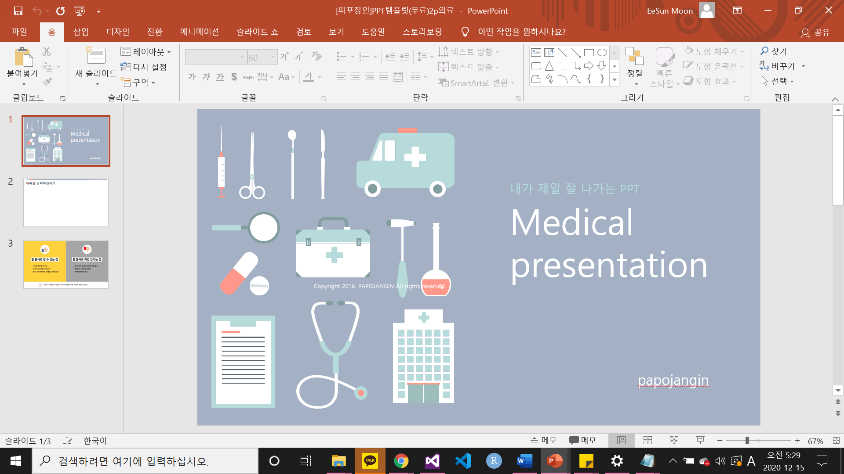

Smart Device Engineering Major
In the Intelligent Electrical Engineering Department
19011773 Moon EeSun

Slide 2

Algorithm Semester Project
COVID-19
Visitor manager

Slide 3



Algorithm Semester Project
1. Introduction
1. Introduction
COVID-19
Visitor manager
2. About code
3. C-Code
4. Conclusion

Slide 4

1. Introduction
COVID-19 virus
Notes:
코로나19 바이러스

Slide 5


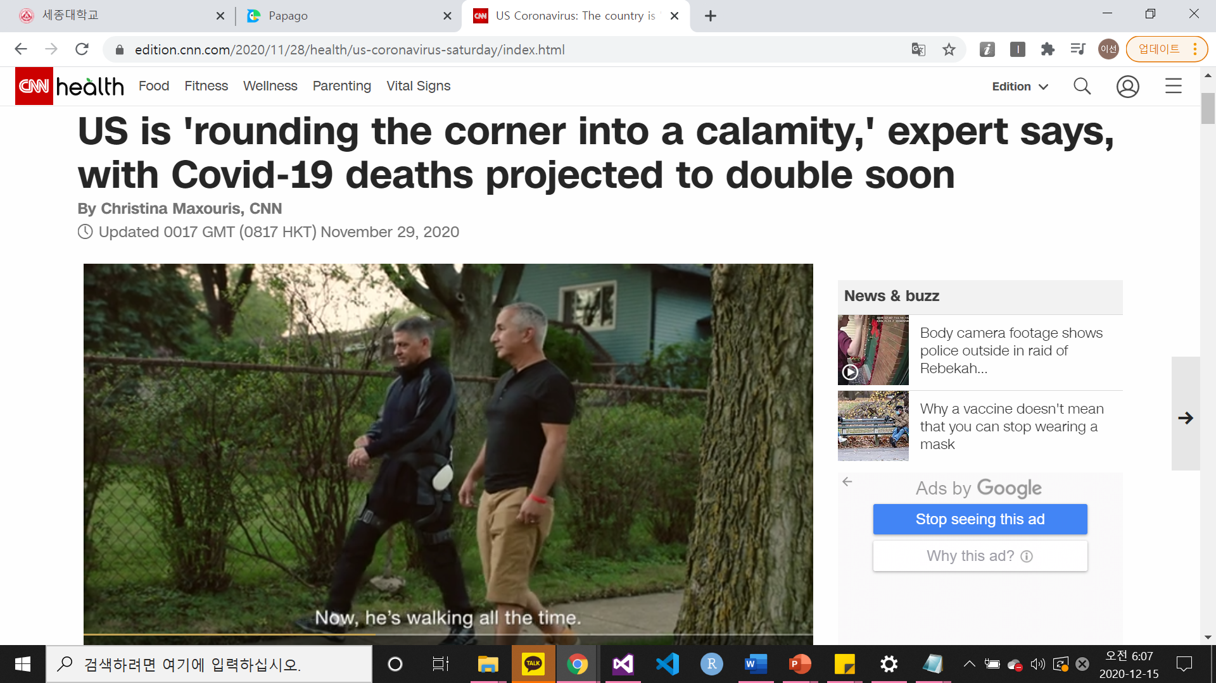
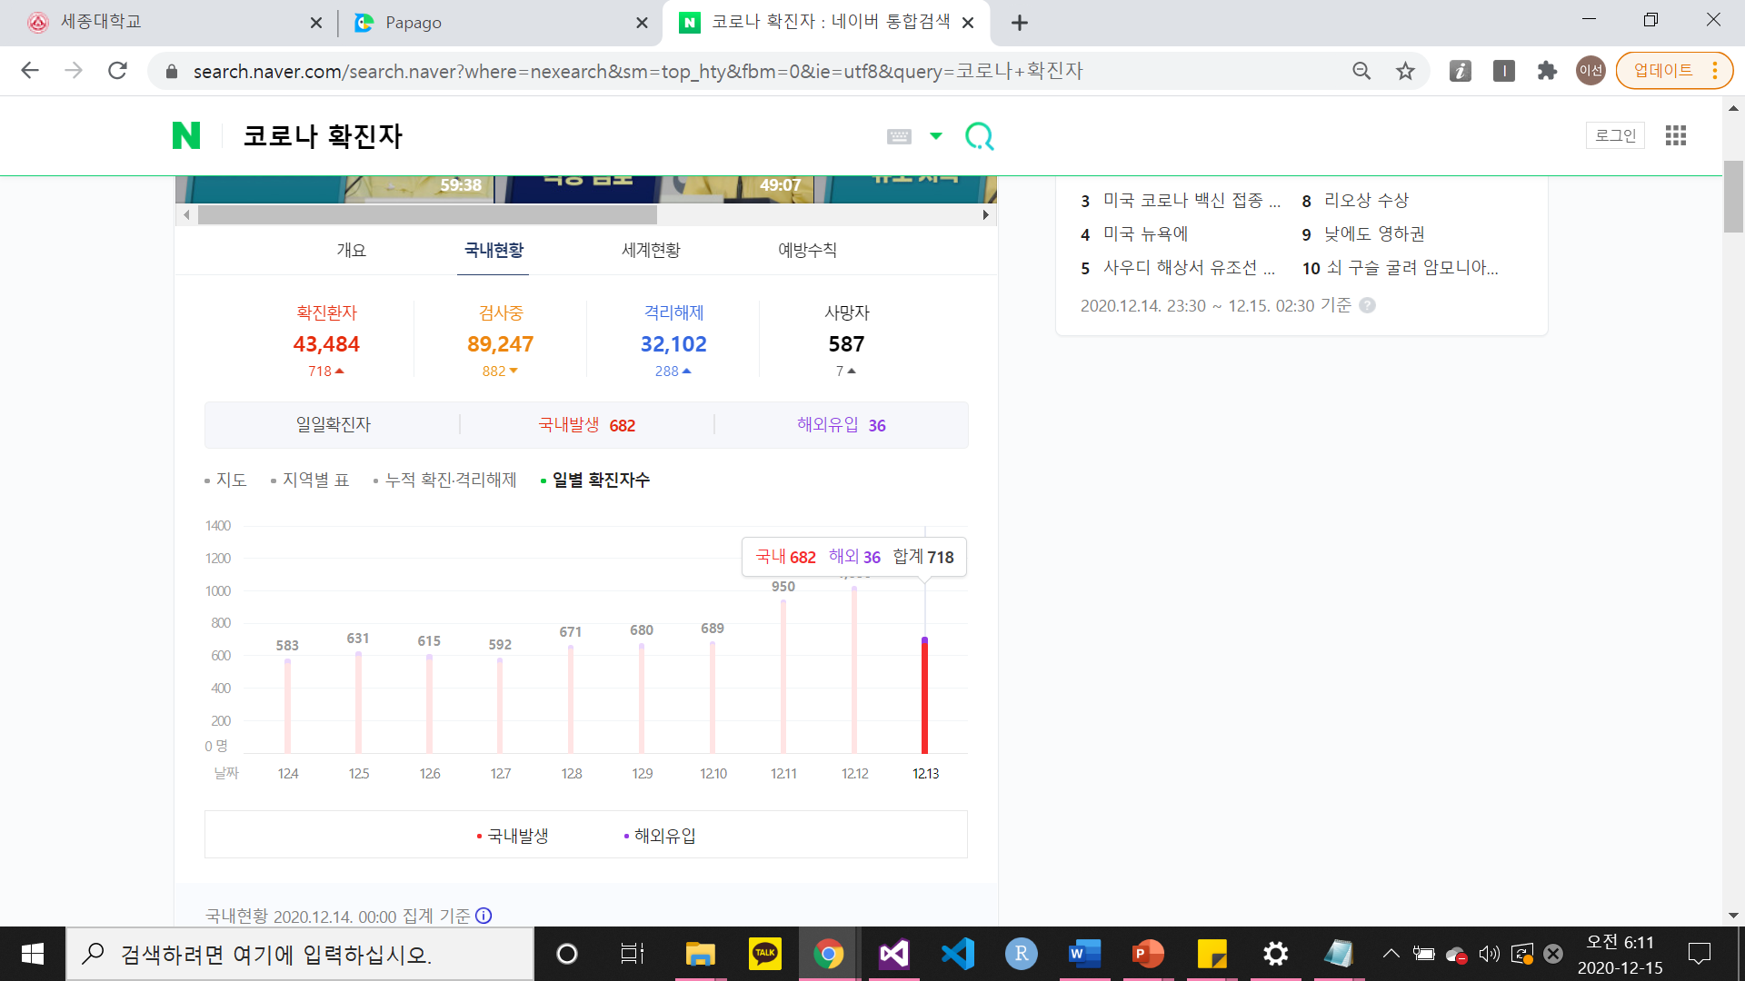
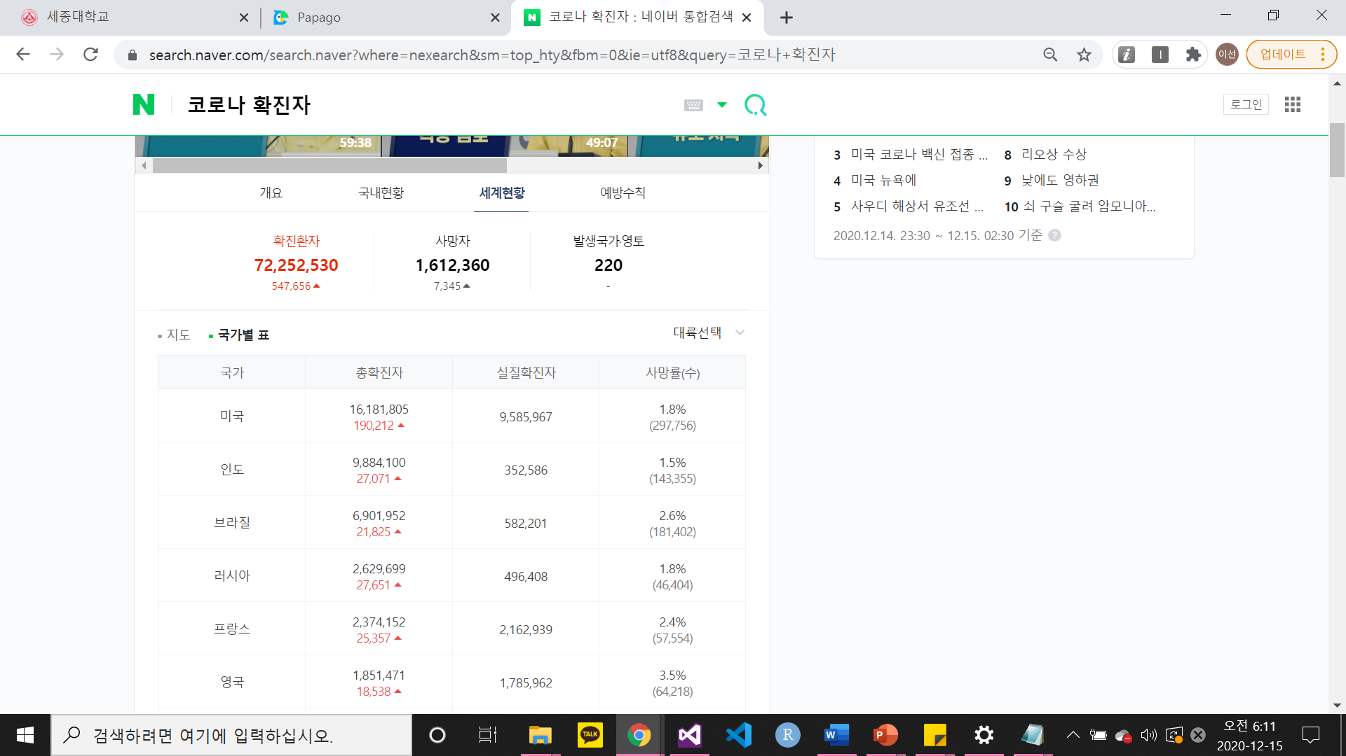
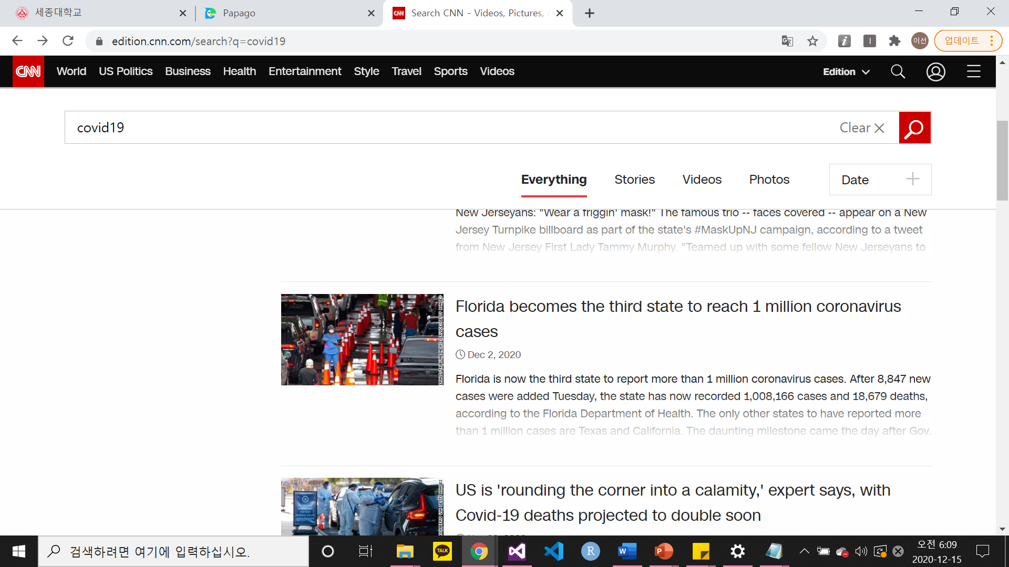
1. Introduction
Notes:
코로나 바이러스의 확산세는 전 세계적으로 퍼져 나가고 있음

Slide 6



1. Introduction
Visitor’s name
Visited date & time
Visitor’s phone number
Visitor’s residence
Personal information consent status
Notes:
코로나19 확산으로 인해 출입 명부를 쓰는 중

Slide 7





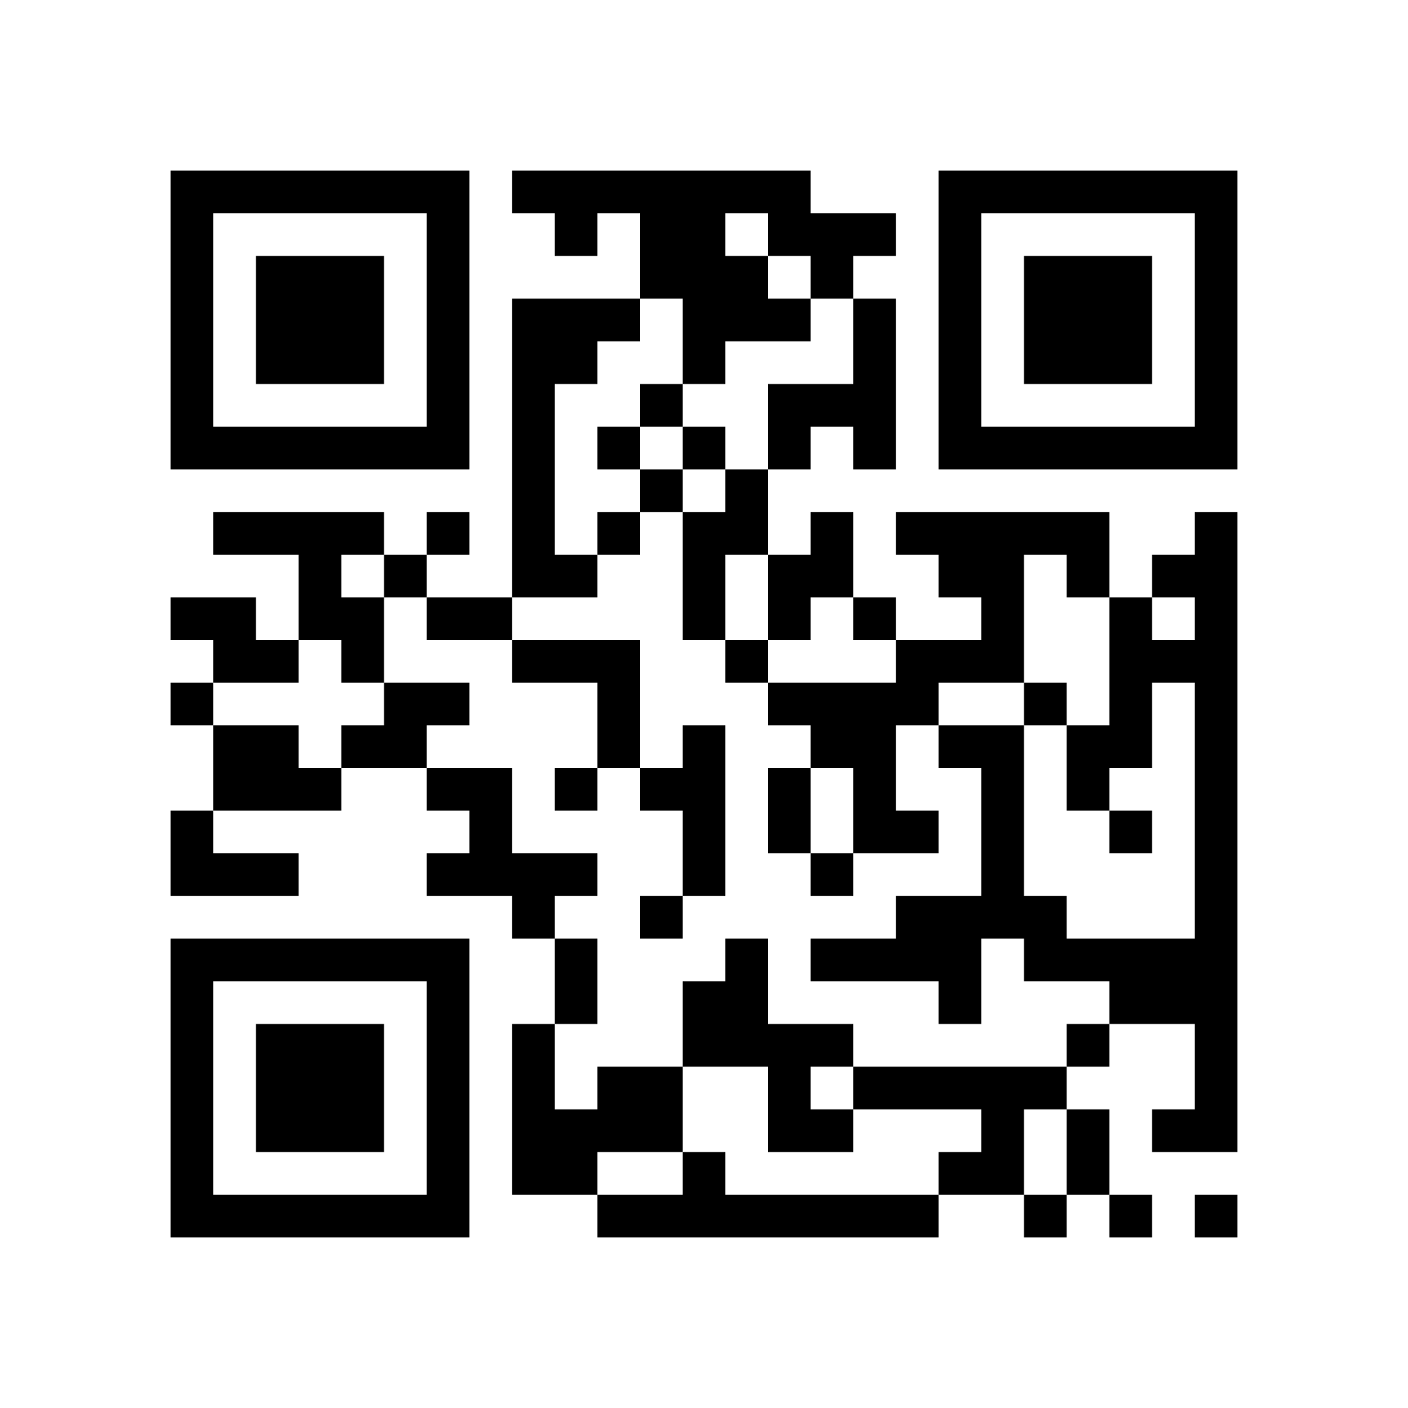

1. Introduction
Notes:
문제점 : 지금까지의 출입기록 명부는 QR코드도 있지만 손으로 쓰는 경우가 많음
손으로 쓰는 경우에는 컴퓨터로 바로바로 입력이 어려움 & 보안 어렵

Slide 8


1. Introduction
Save automatically
entered
information
to computer
Notes:
내가 구현한 것 -> c언어 프로그래밍을 통해 자동으로 입력한 정보를 컴퓨터에 저장하는 효과

Slide 9

1. Introduction
1. Introduction
2. About code
2. About code
3. C-Code
4. Conclusion

Slide 10


2. About code
Visitor
Visitor Node Structure
Visitor’s Name,
Visitor’s code(random),
Visited date, phone number, residence code, body temperature, overseas trip status,
Personal information consent status

Slide 11
2. About code
Visitor
1. Registration
Visitor’s name, Visited date,
Phone number, Residence code,
Body temperature,
Overseas trip status,
Personal information consent status
->Status(0, 1)
2. Modification
After self-certification
with visitor code

Slide 12

2. About code
1. Registration - Same as visitor mode
Manager
2. Modification - Same as visitor mode
3. Delete
Information prior to the date entered
4. Print all data
By name
By visited date
By residence
5. Print specific data
By name
By visited date
By residence

Slide 13


2. About code
Manager
ID : byecovid19
PW : plzbyecovid19
Press 0
3. Delete
The personal information of visitors
cannot be deleted by anyone.
4. Print all data
5. Print specific data
It is dangerous to make
a visitor's personal information
publicly visible.

Slide 14


2. About code
Structure
STRUCTURE
MENU
INITIALIZATION
Visitor
Visitor List
HashTable
First greeting
Mode_menu
Manager_menu
Visitor_menu
Residence_menu
Closing greeting
Visitor
Visitor List
HashTable

Slide 15



2. About code
SORTING
SEARCH
PRINT
Using Merge Sort
By name
By visited date
By code
By name
By visited date
By residence
Entered data
Print one visitor data
Print all data
Print by name
Print by visited date
Print by residence

Slide 16



2. About code
REGISTRATION(ADD)
MODIFICATION
DELETE
Name : can duplicated
Date>=20200101
0<=region code<=26
35<=temperature<=37.2
Oversea status : 1 (NO)
Personal info status : 1 (YES)
self-certification with visitor code
ONLY
visitor’s name,
phone number
Body temperature
can be modified.
Delete all data
prior to the date entered

Slide 17
2. About code
1. Introduction
2. About code
3. C-Code
3. C-Code
4. Conclusion

Slide 18
C-Code & Conclusion

Slide 19
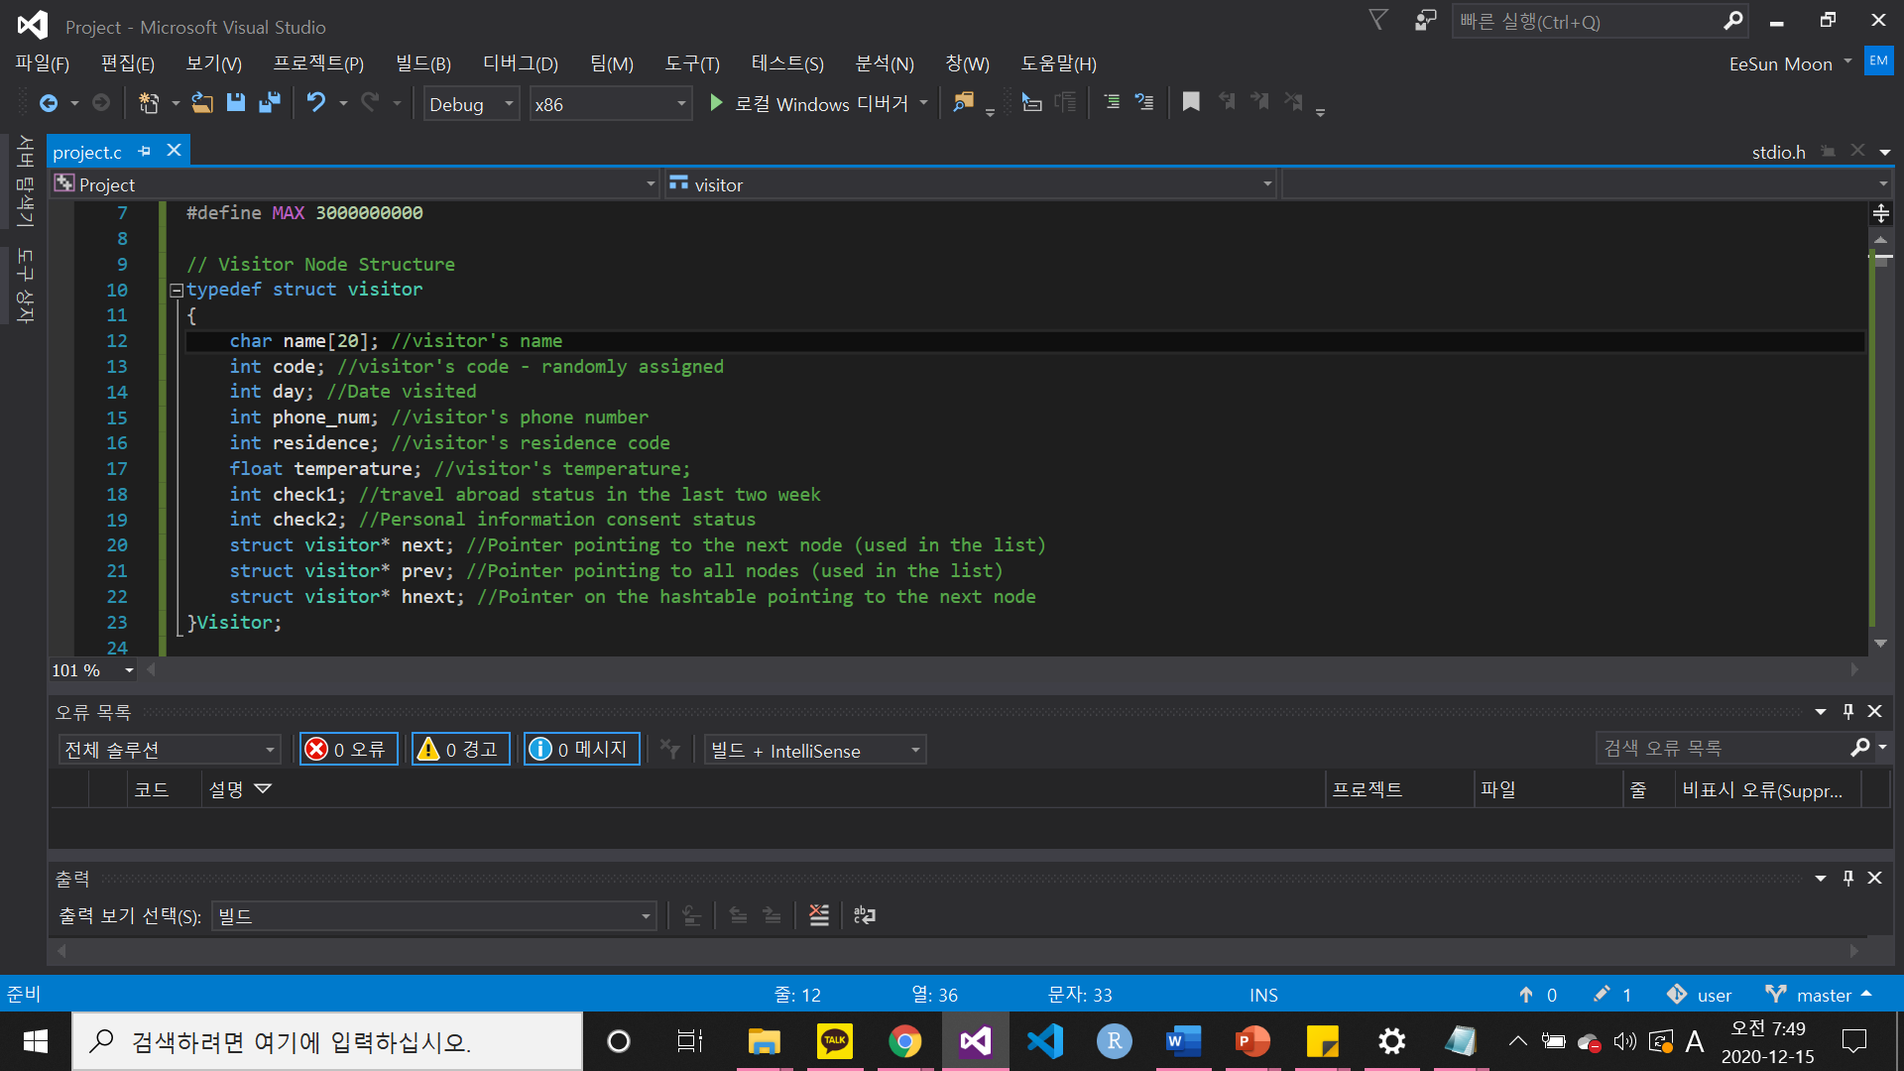
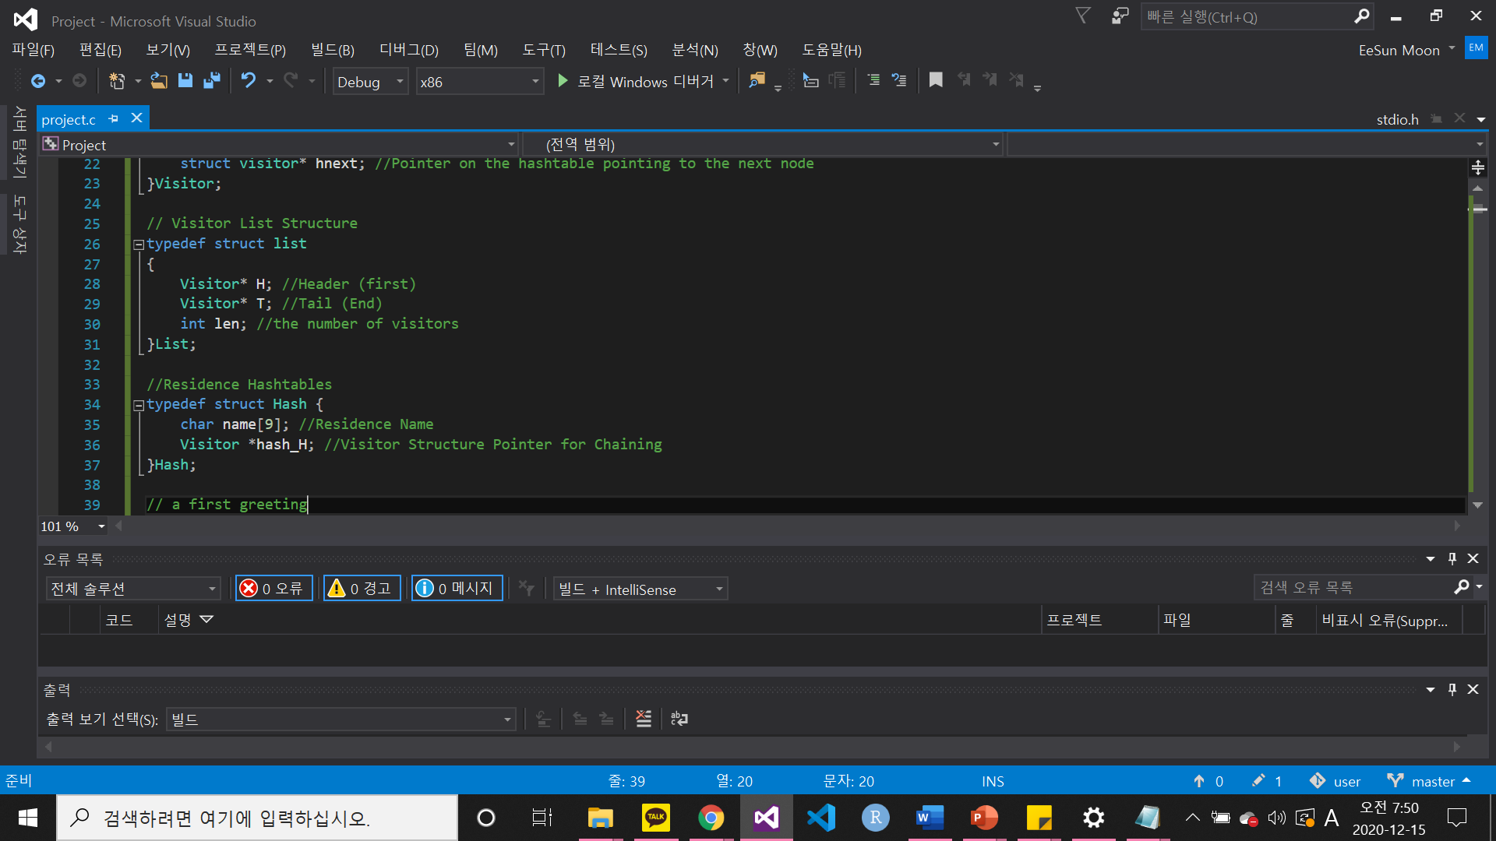
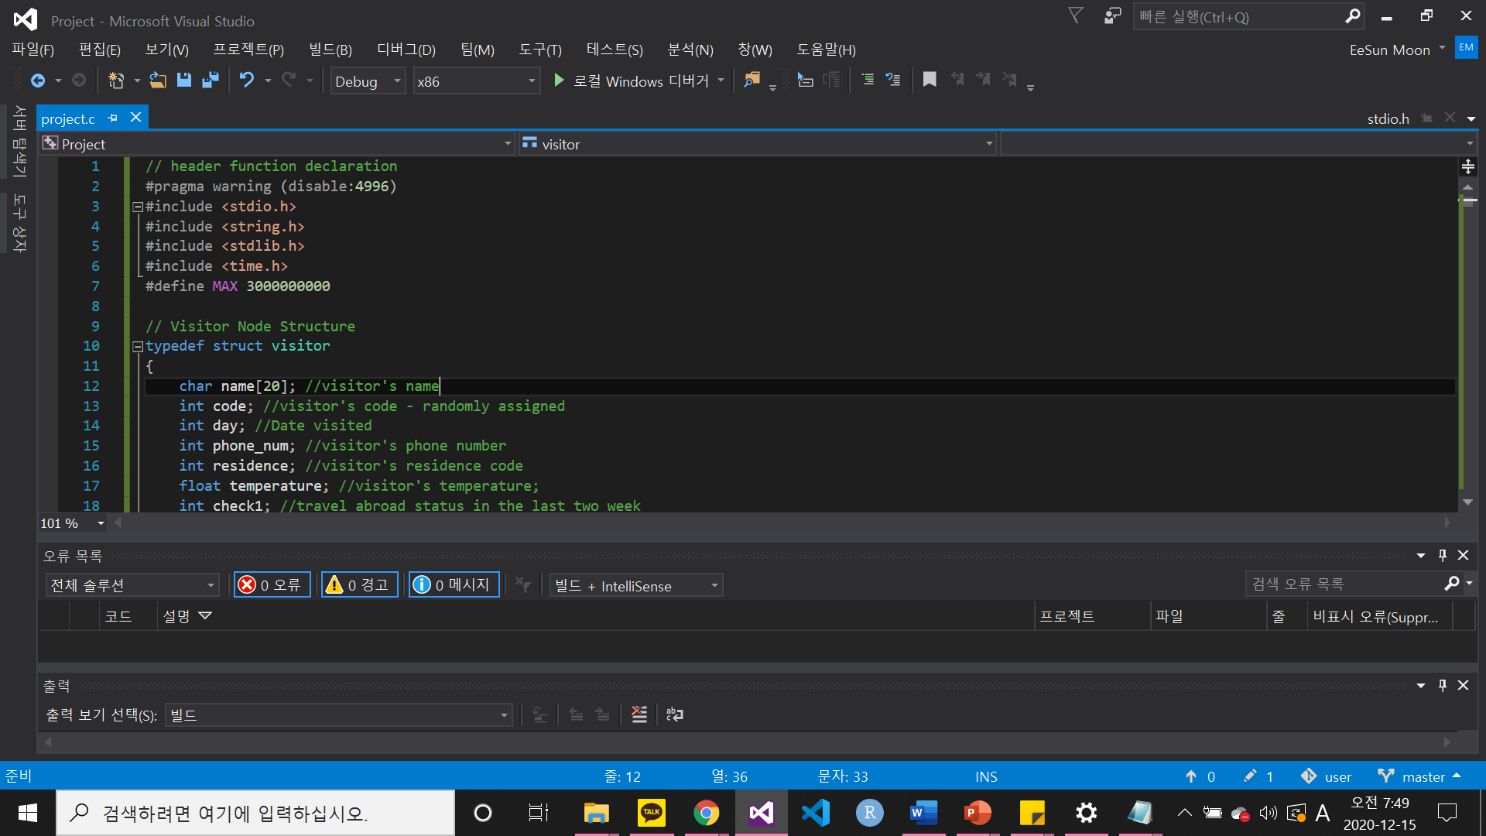
3. C-Code : Structure
Structure
STRUCTURE
Visitor
Visitor List
HashTable
Visitor
Visitor List
HashTable
‘residence’ info

Slide 20
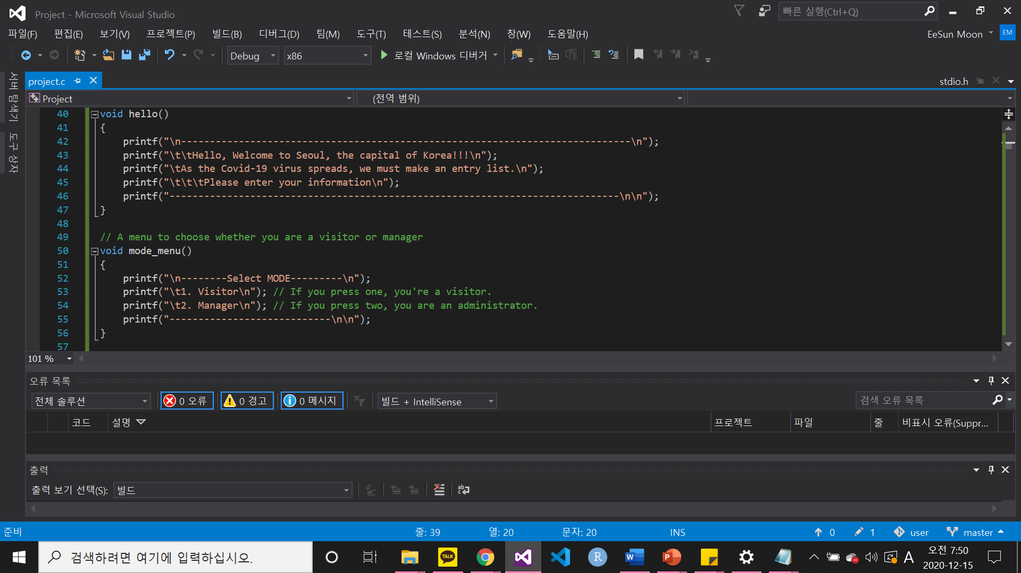
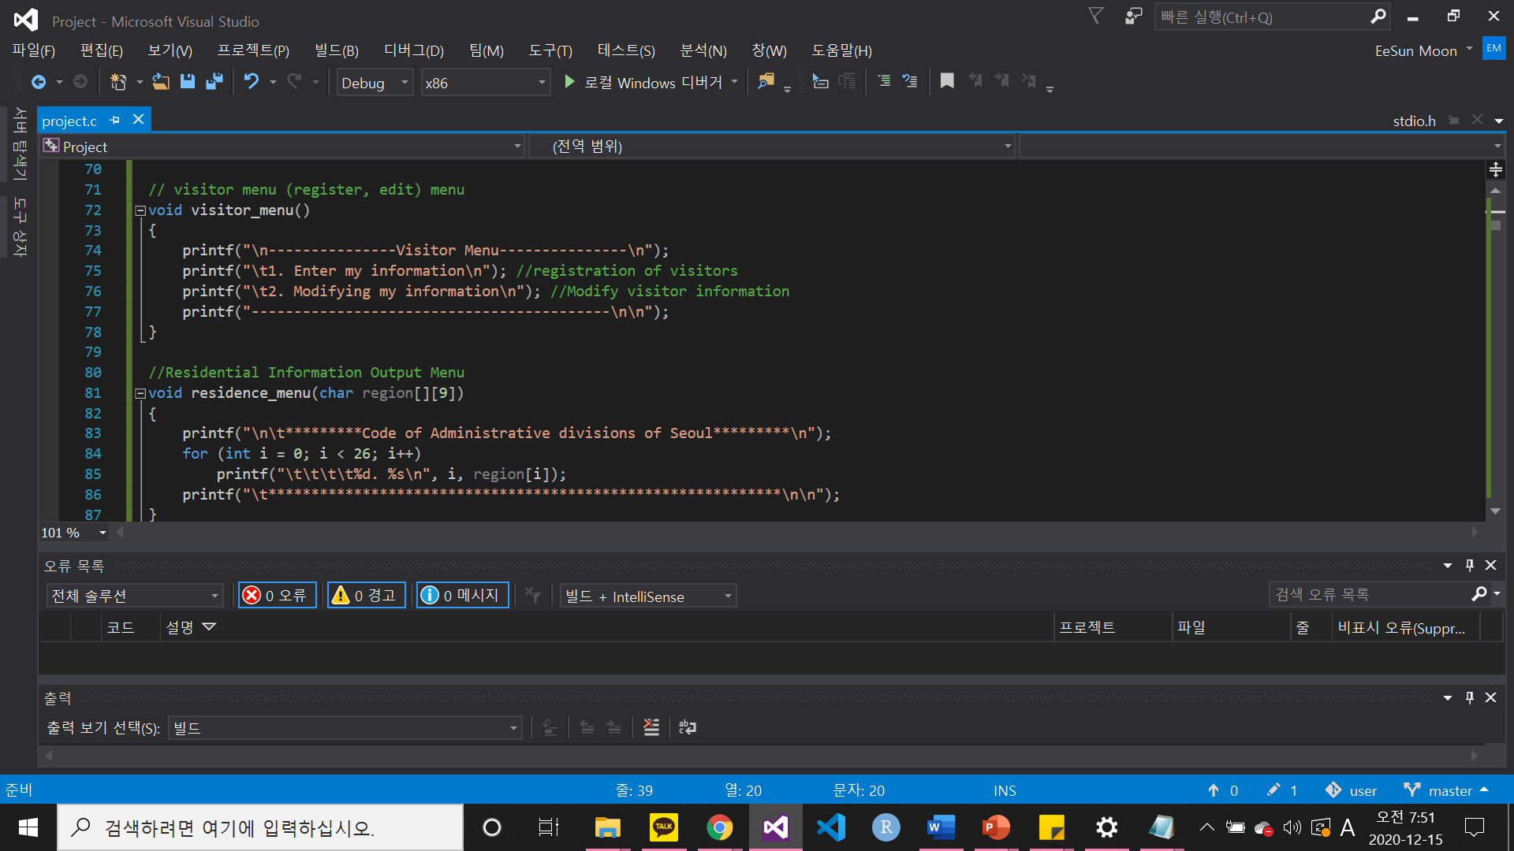
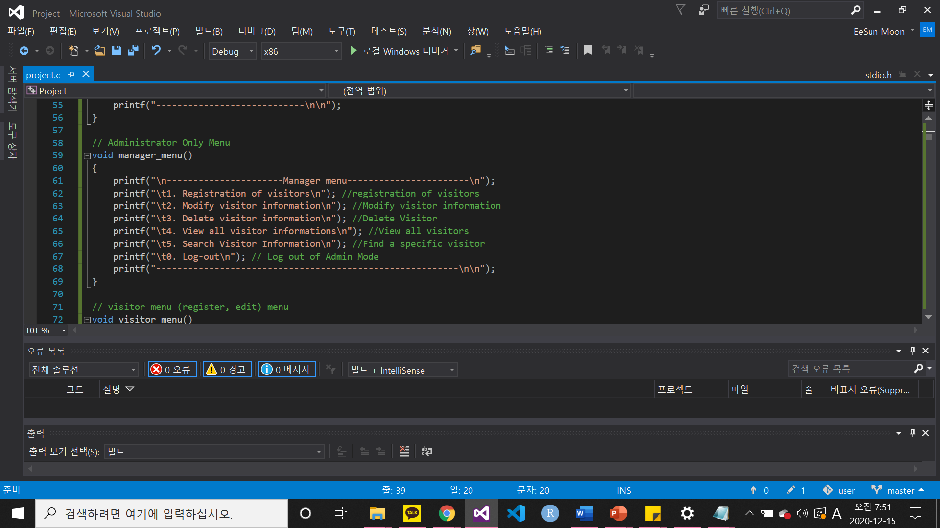
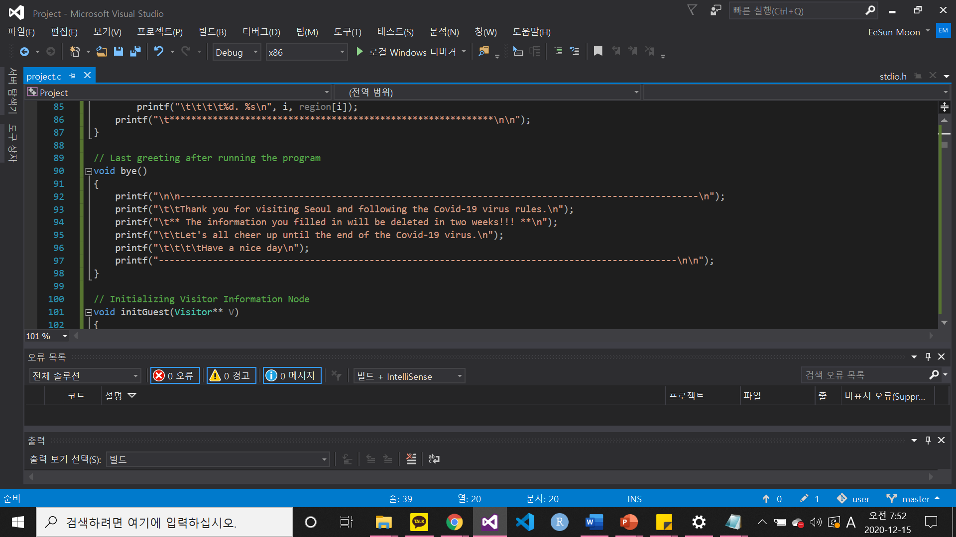
3. C-Code : Menu
MENU
First greeting
First greeting
Mode_menu
Manager_menu
Visitor_menu
Residence_menu
Closing greeting
Mode_menu
Manager_menu
Visitor_menu
Residence_menu
Closing greeting

Slide 21
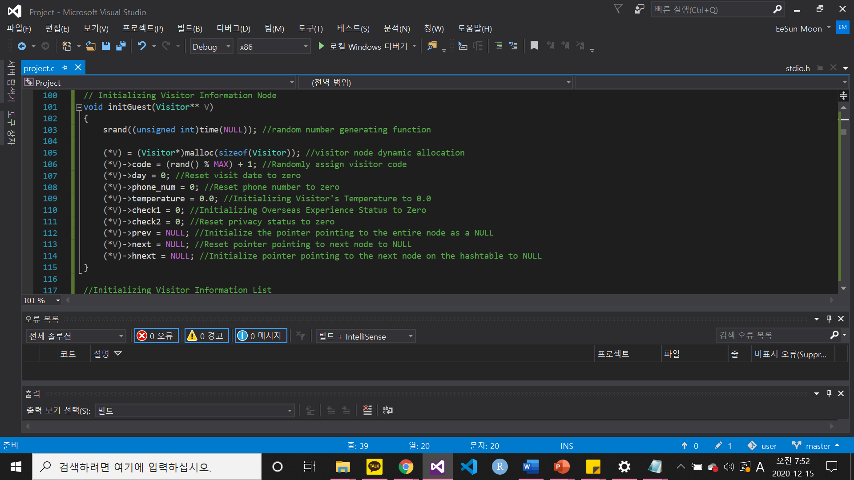
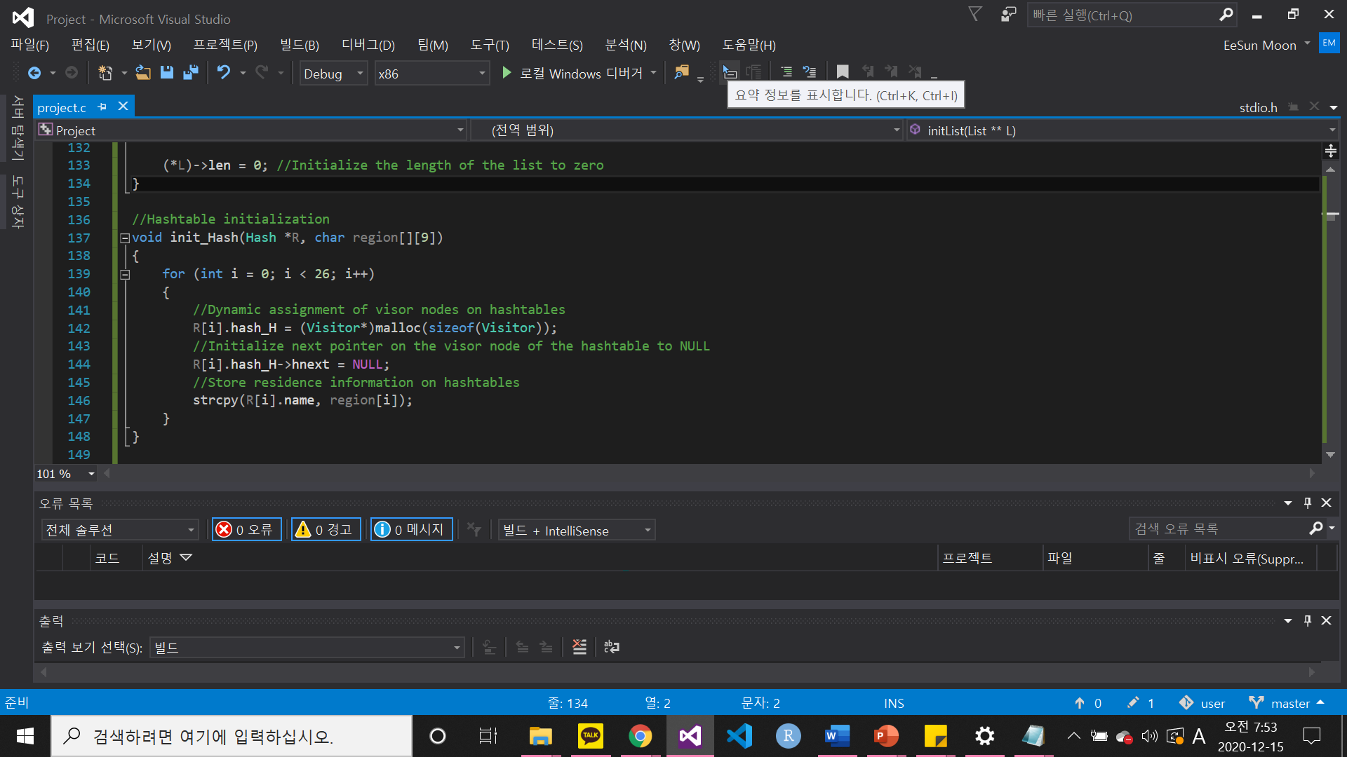
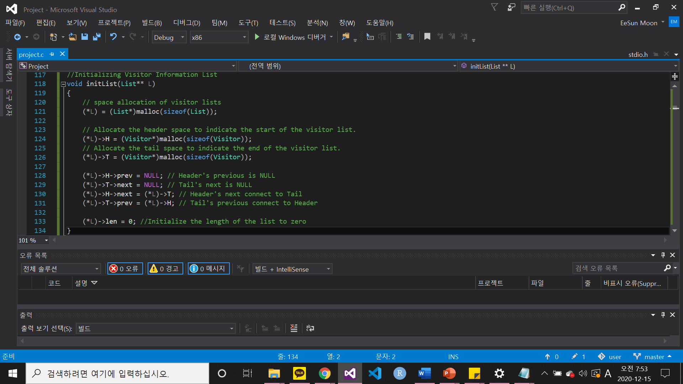
3. C-Code : Initialization
INITIALIZATION
Visitor
Visitor
Visitor List
HashTable
Visitor List
HashTable

Slide 22
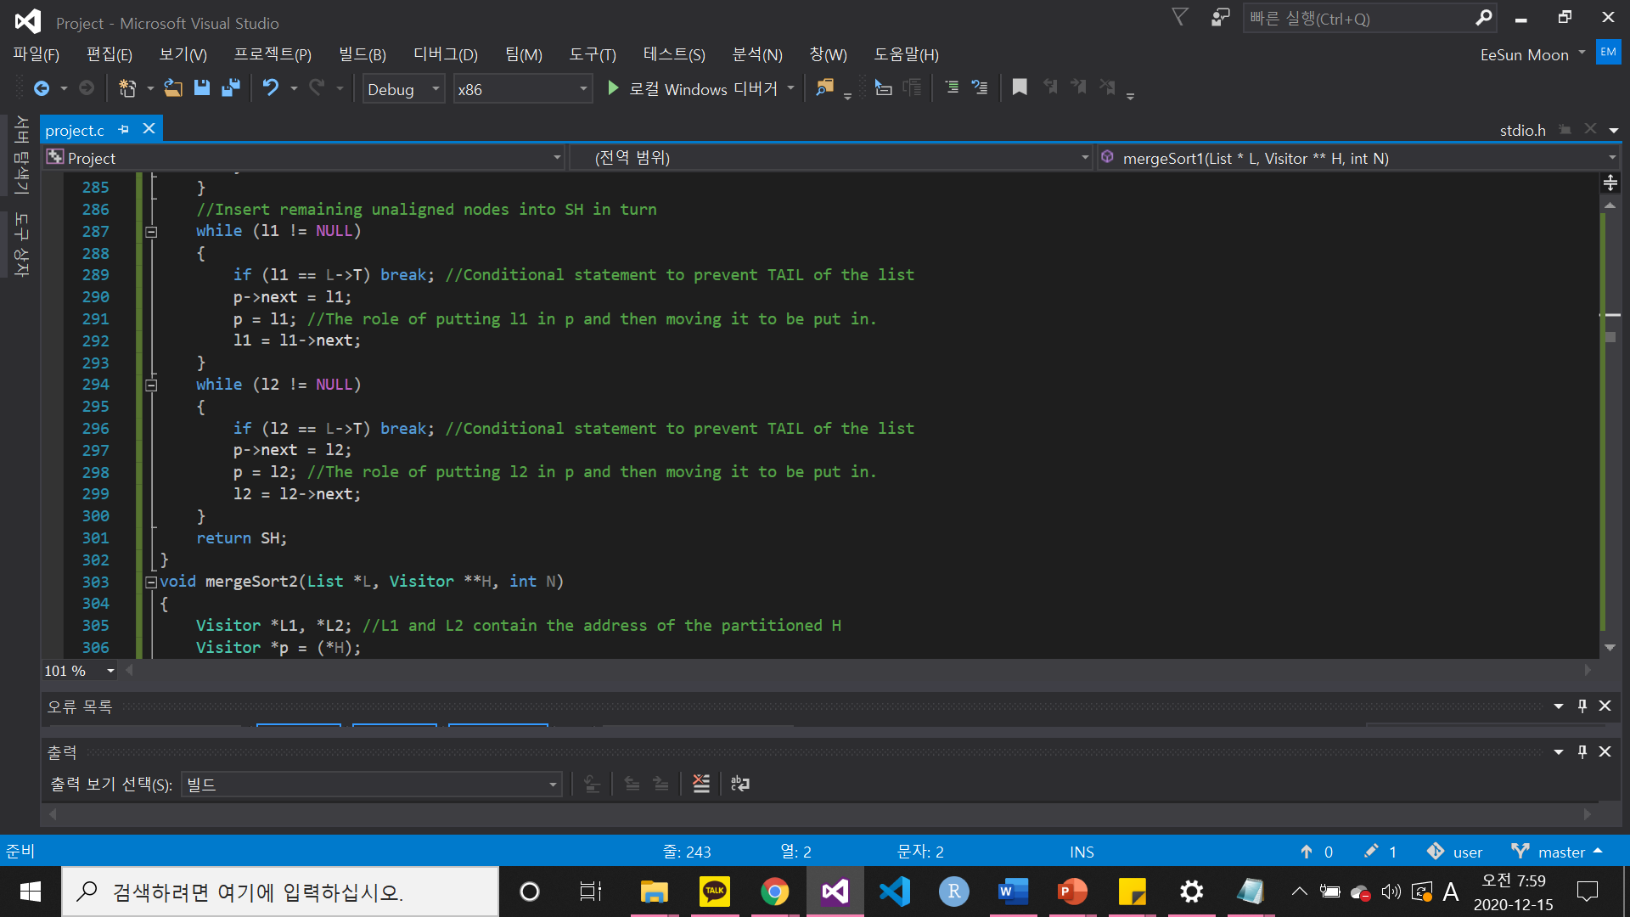
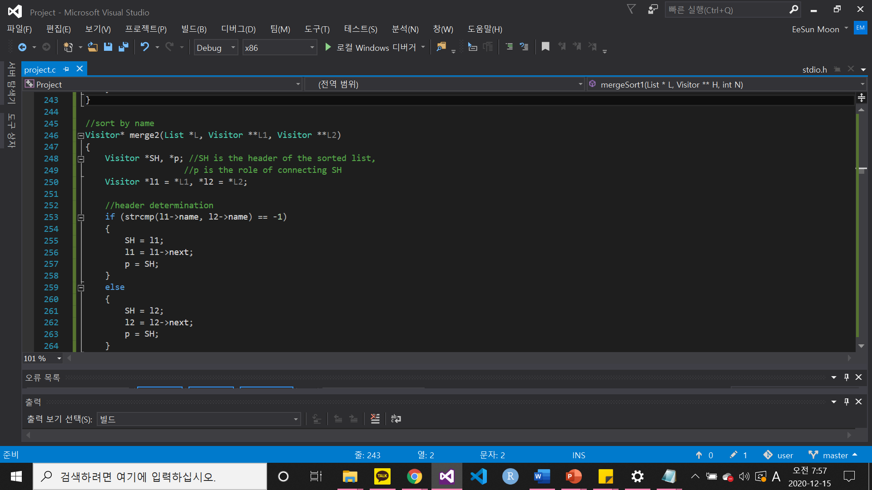
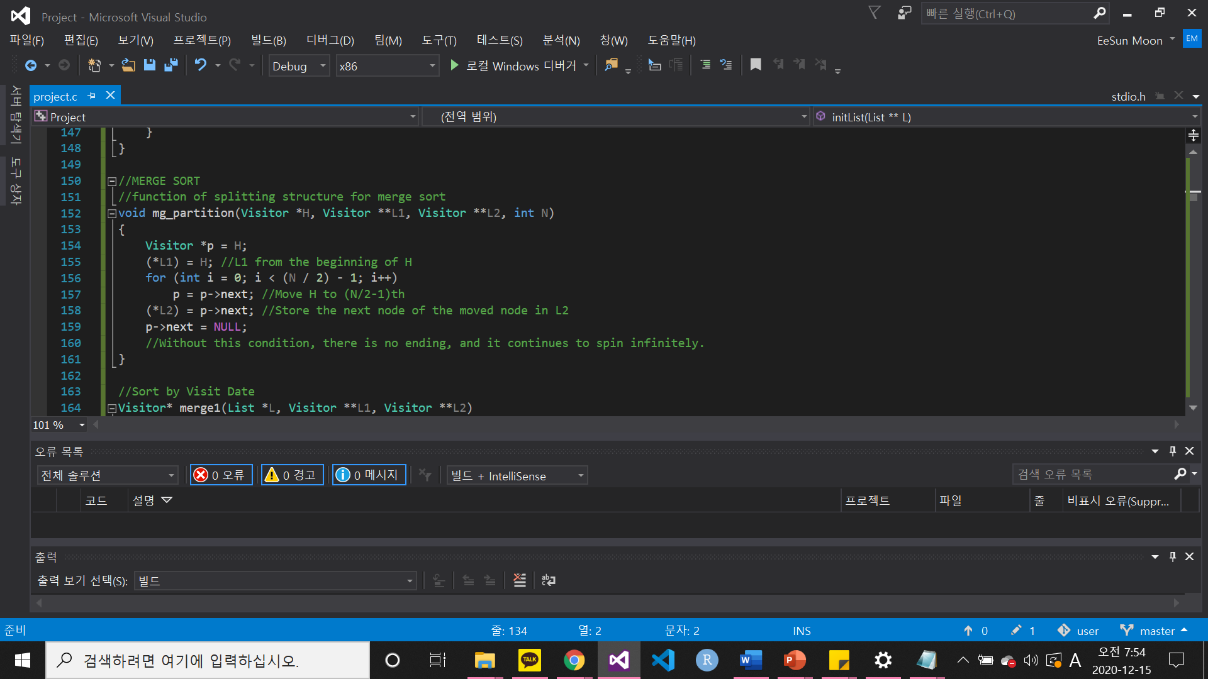
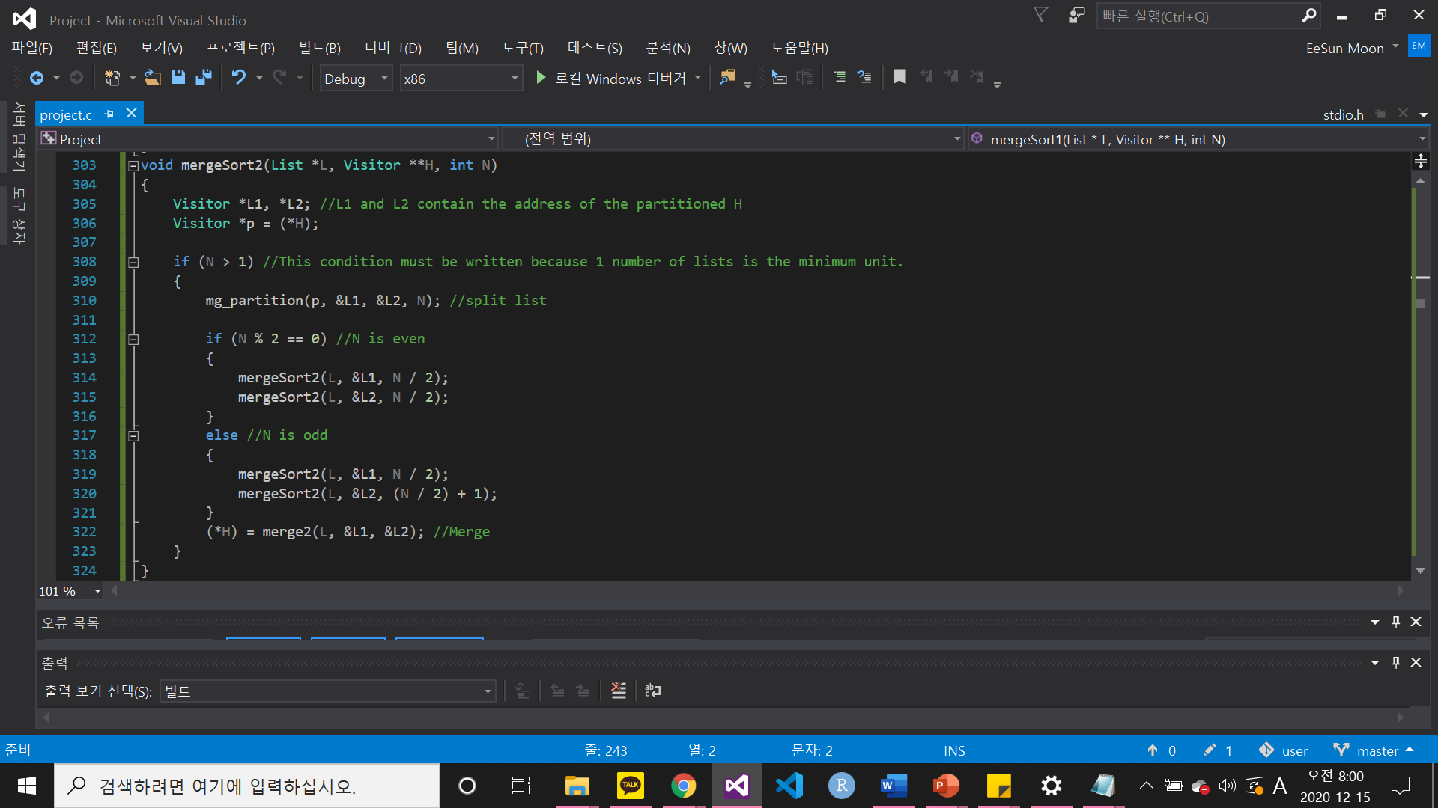
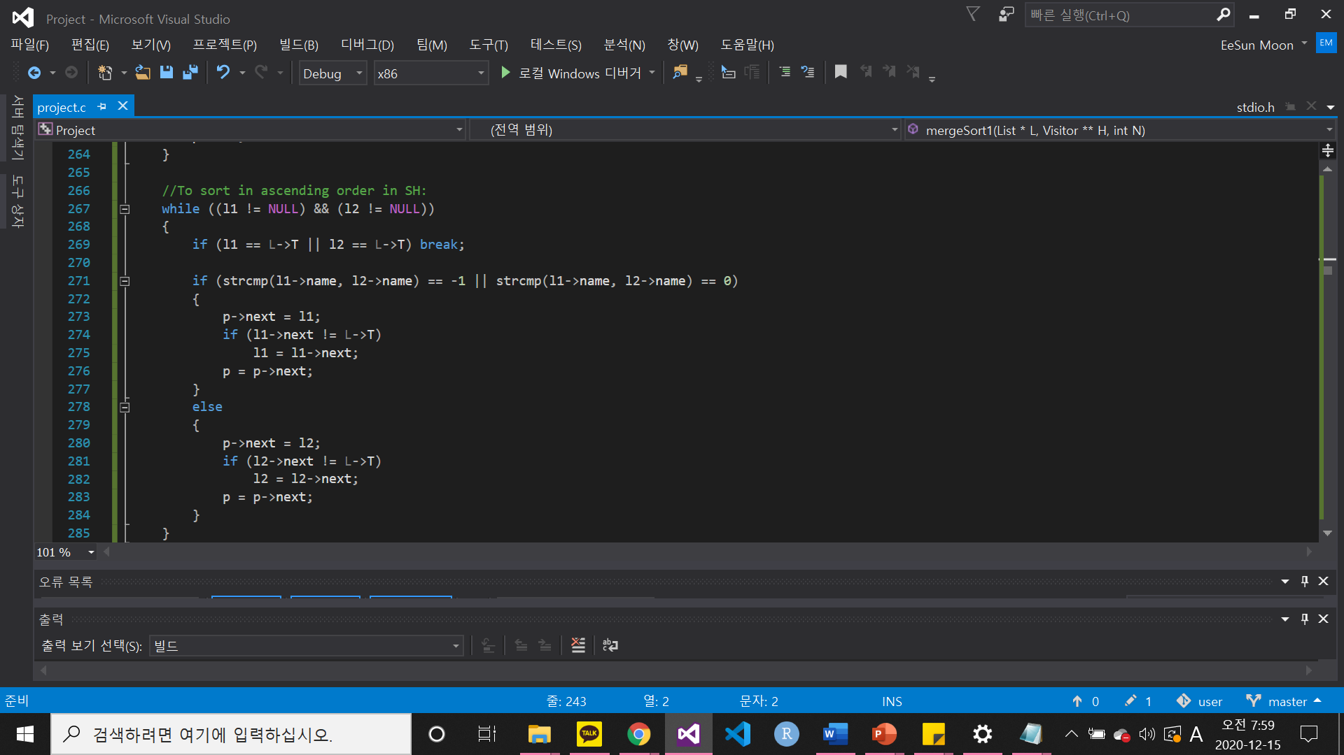
3. C-Code : Sorting by name
SORTING
Using Merge Sort
Using Merge Sort
By name
By visited date
By name

Slide 23
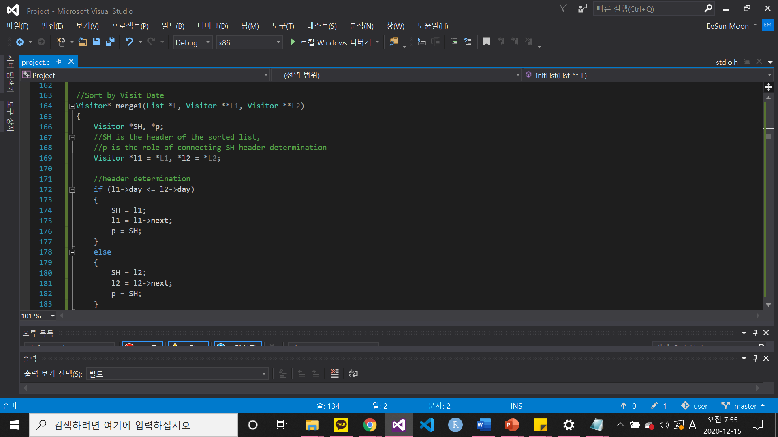
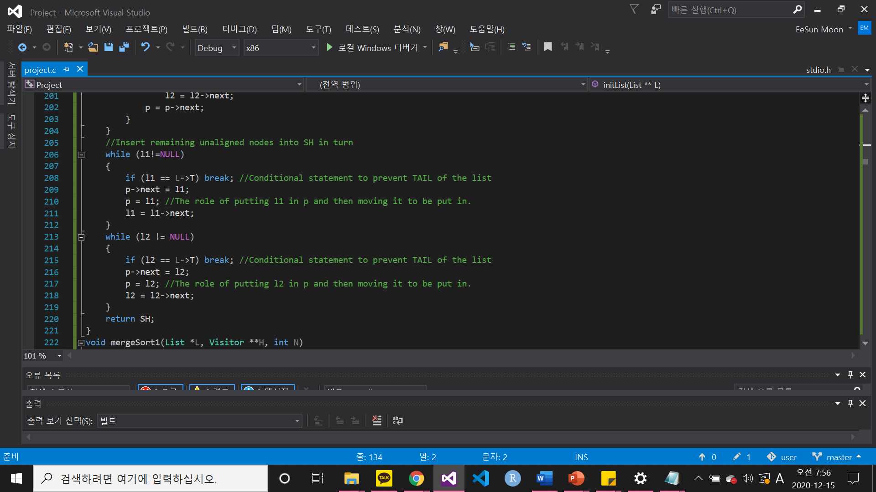

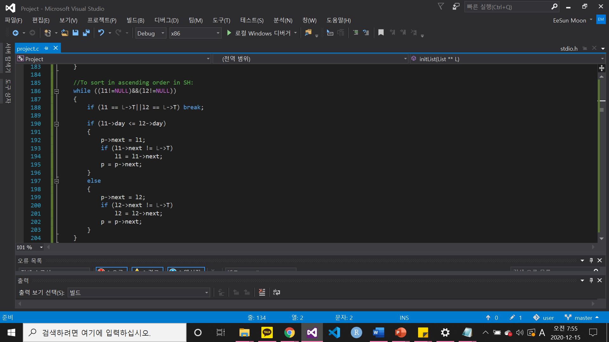
3. C-Code : Sorting by visited day
SORTING
Using Merge Sort
Using Merge Sort
By name
By visited date
By name
By visited date

Slide 24
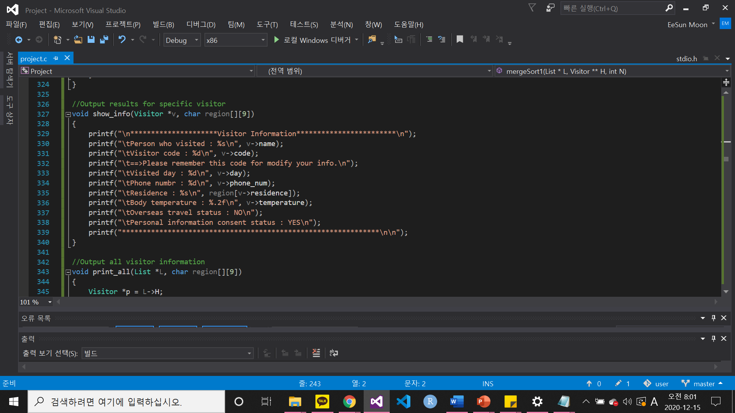

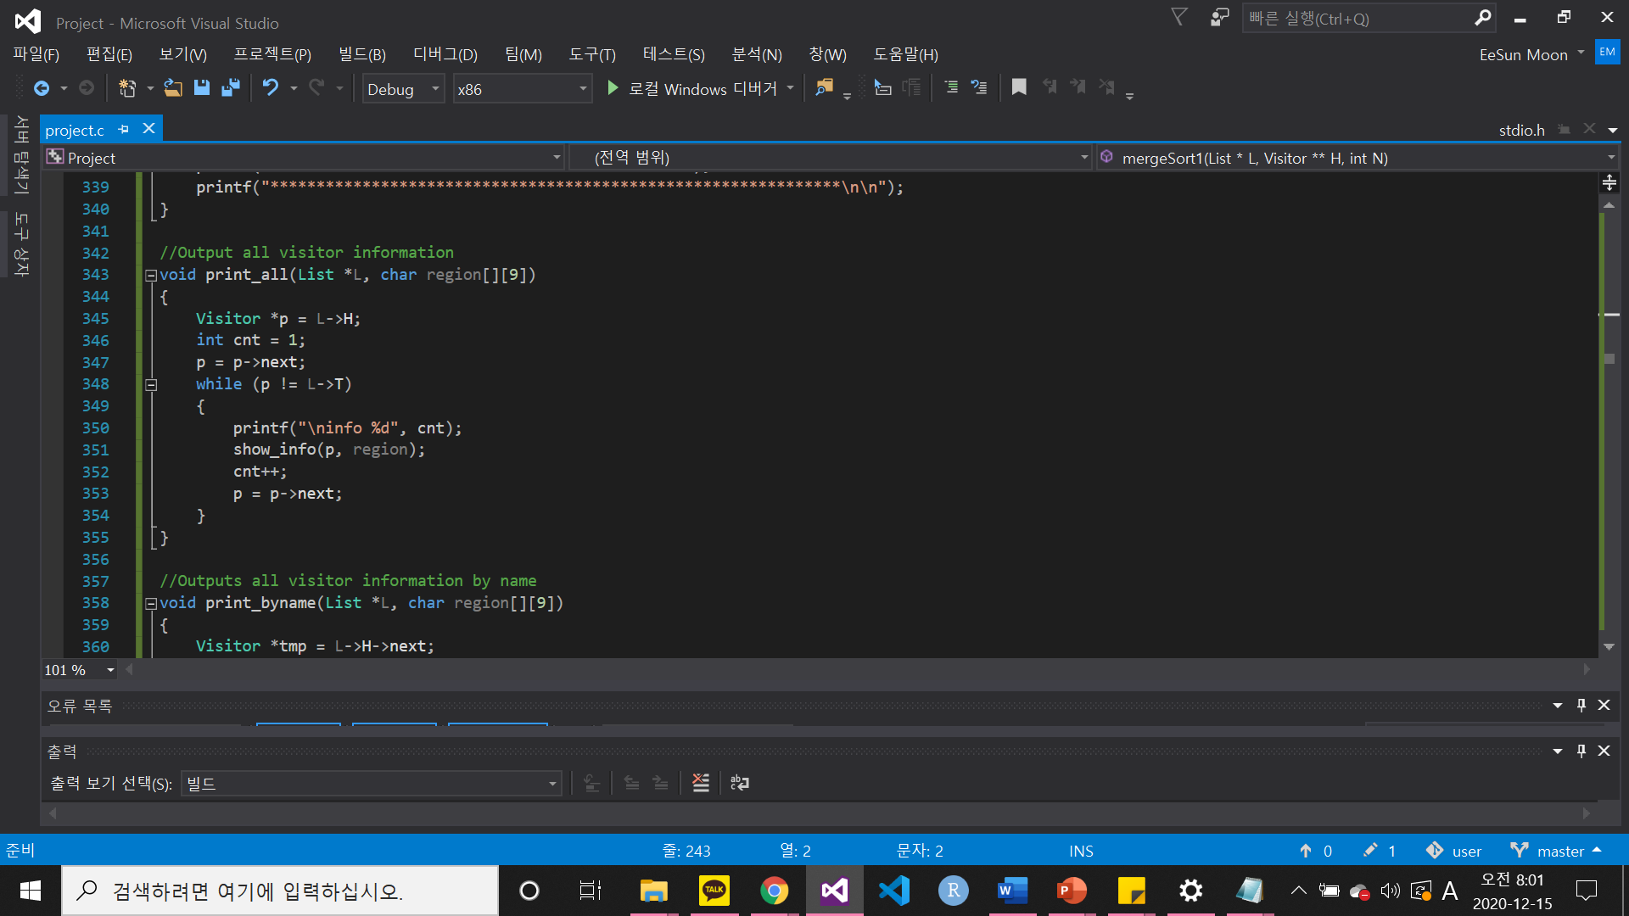

3. C-Code : Print
PRINT
Several
‘show_info’ functions
constitute
‘print_all’ function.
Entered data
Print one visitor data
Print all data
Print by name
Print by visited date
Print by residence
Print one visitor data
Print all data

Slide 25
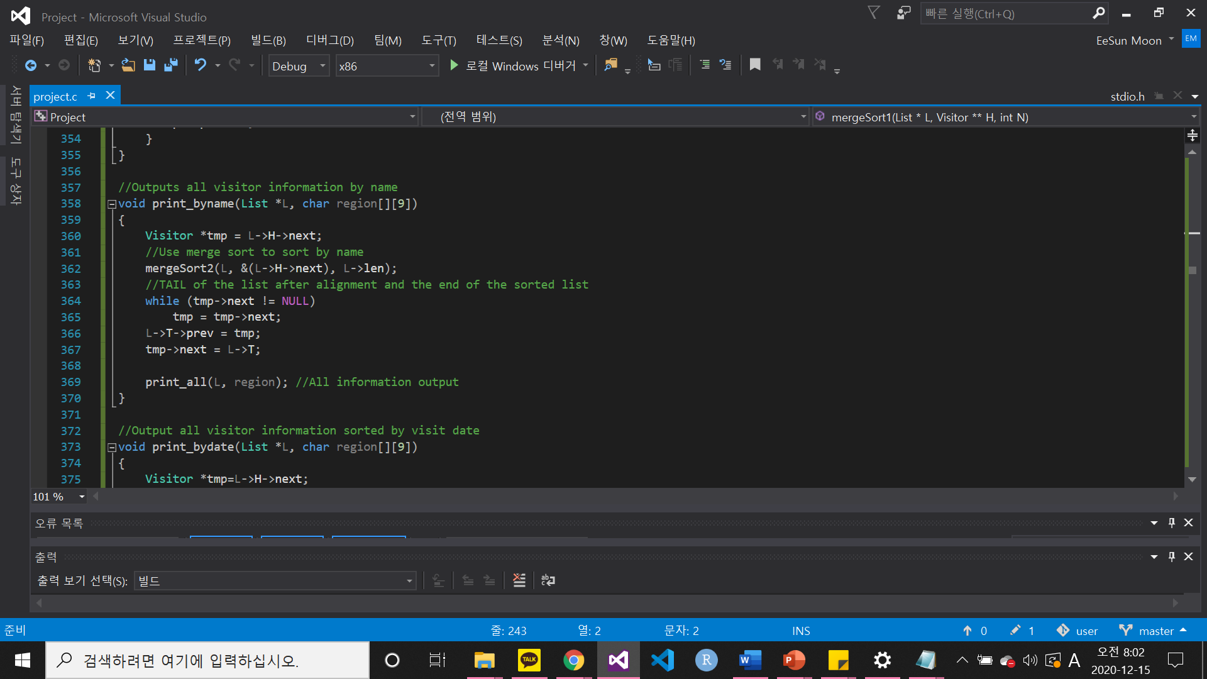

3. C-Code : Print
To sort and output data
using merge sort
PRINT
Entered data
Print one visitor data
Print all data
Print by name
Print by visited date
Print by residence
Print one visitor data
Print all data
Print by name
Print by visited date

Slide 26
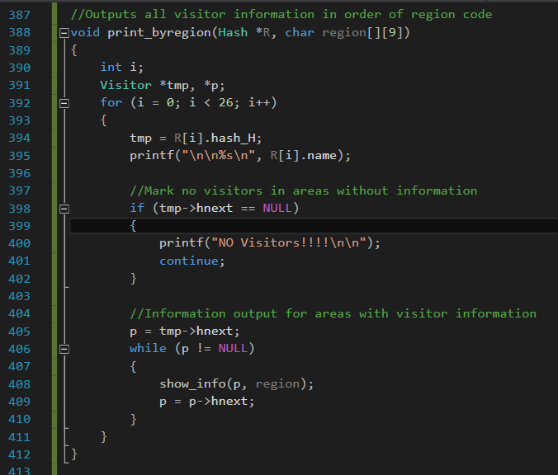
3. C-Code : Print
All region functions use
Hashtable!!
PRINT
Entered data
Print one visitor data
Print all data
Print by name
Print by visited date
Print by residence
Print one visitor data
Print all data
Print by name
Print by visited date
Print by residence

Slide 27
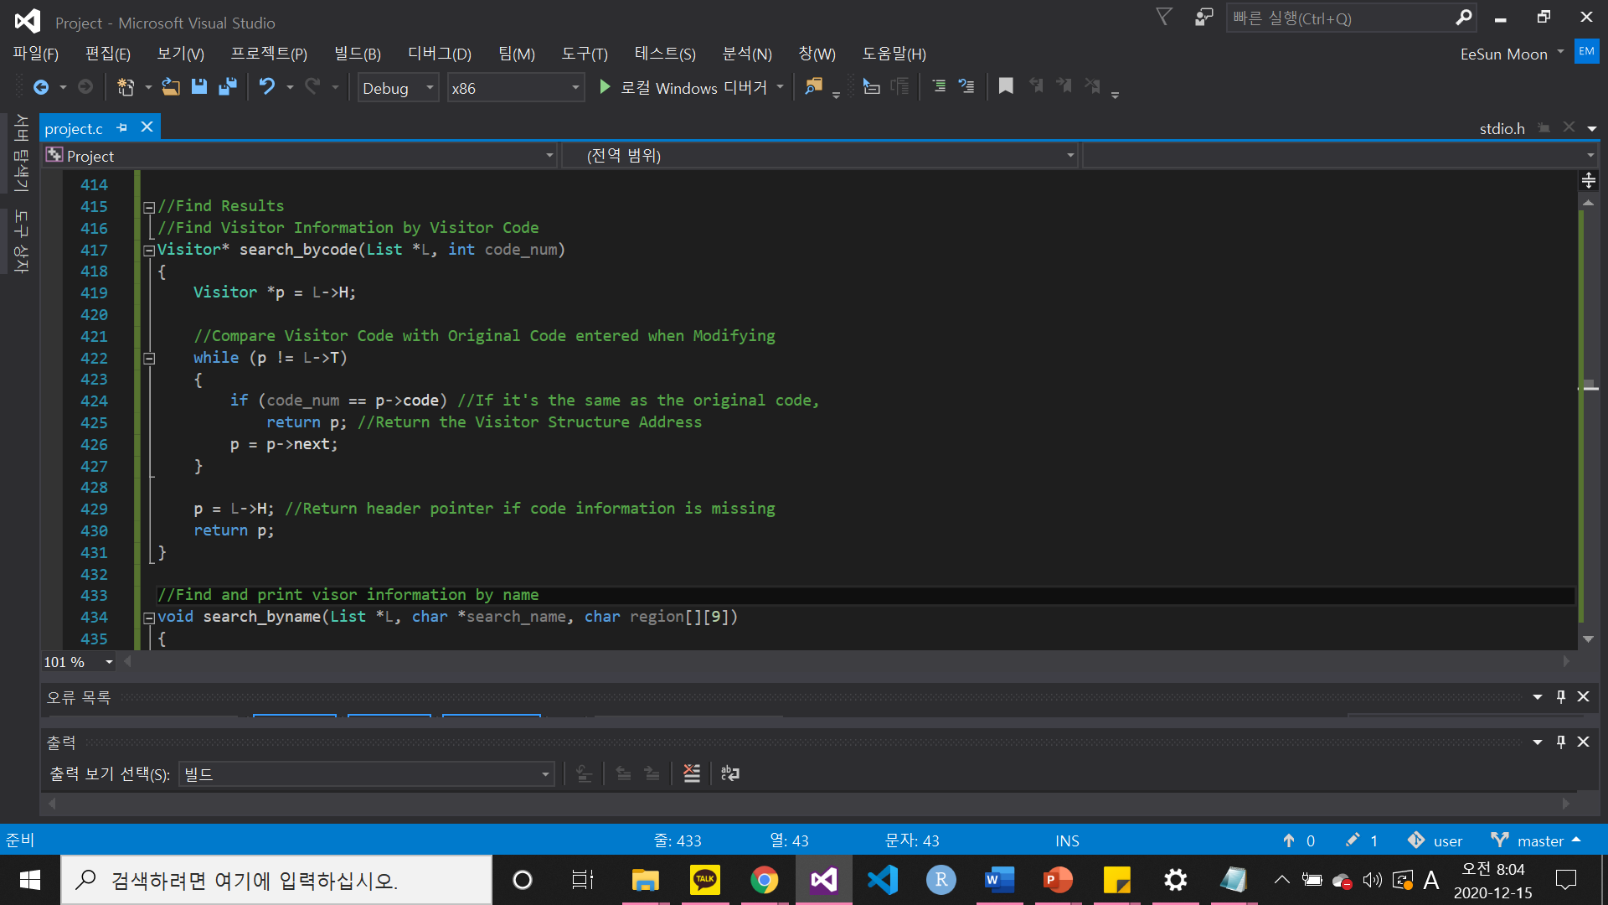
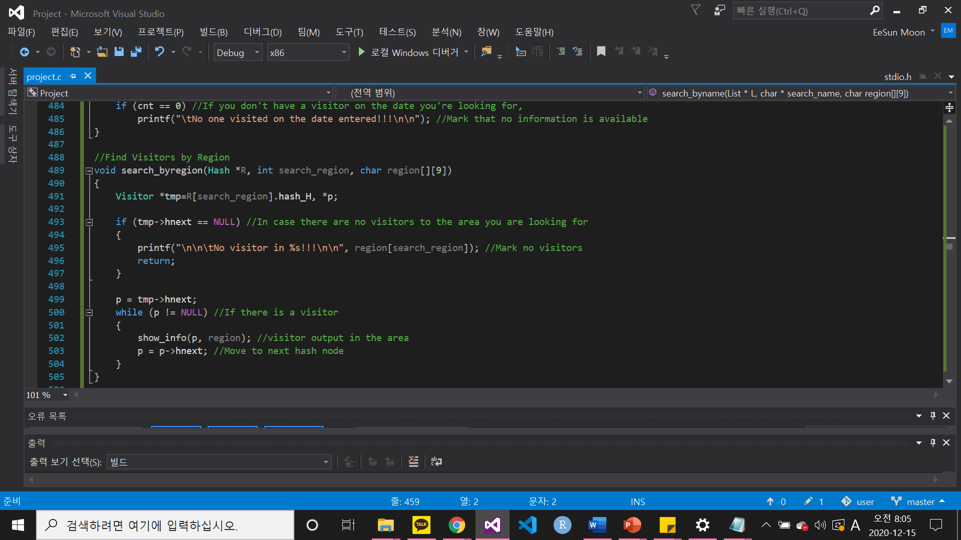
3. C-Code : Search
Validate that the code entered
when modifying information
is correct
SEARCH
By code
By code
By name
By visited date
By residence
By residence

Slide 28
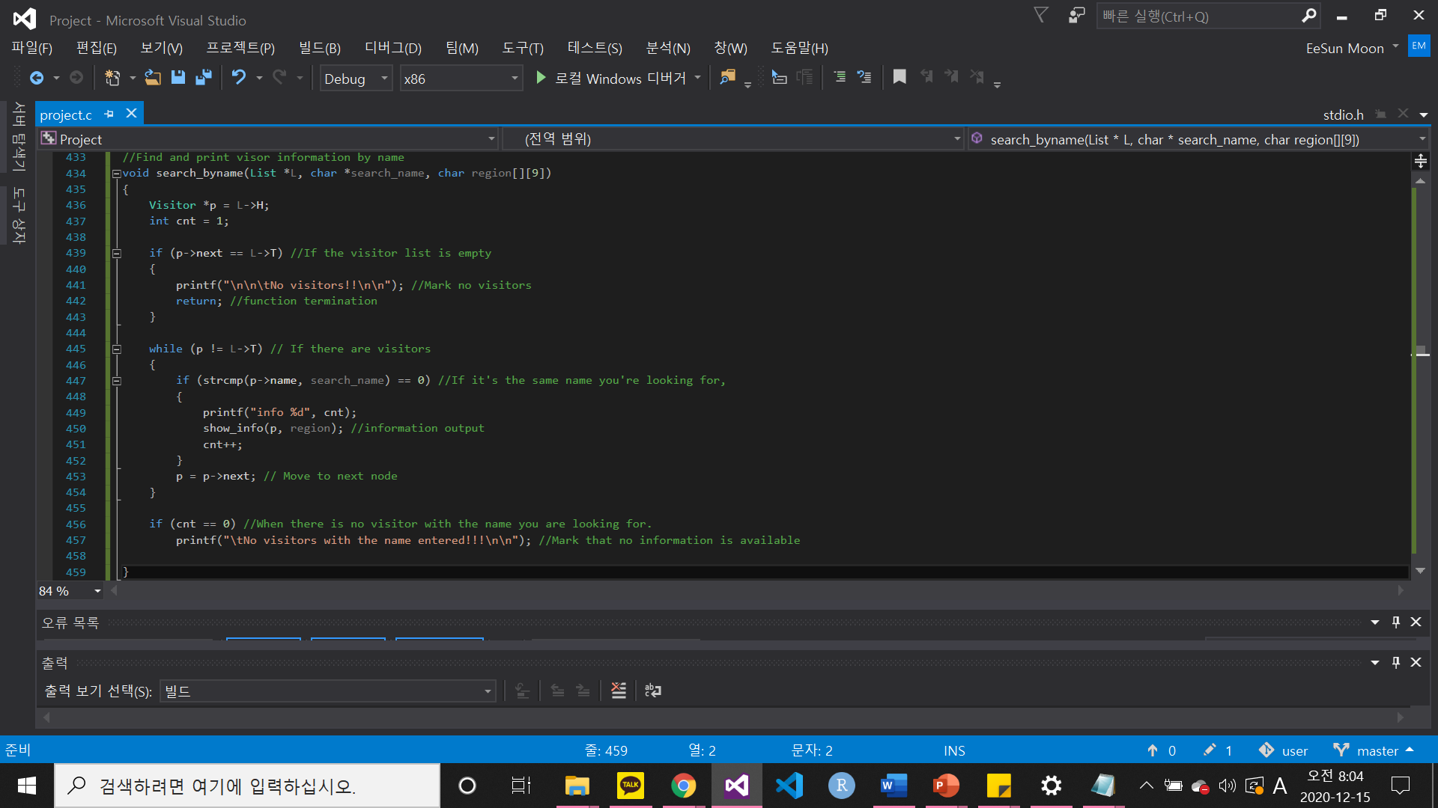

3. C-Code : Search
SEARCH
By code
By code
By name
By visited date
By residence
By name
By visited date
By residence

Slide 29
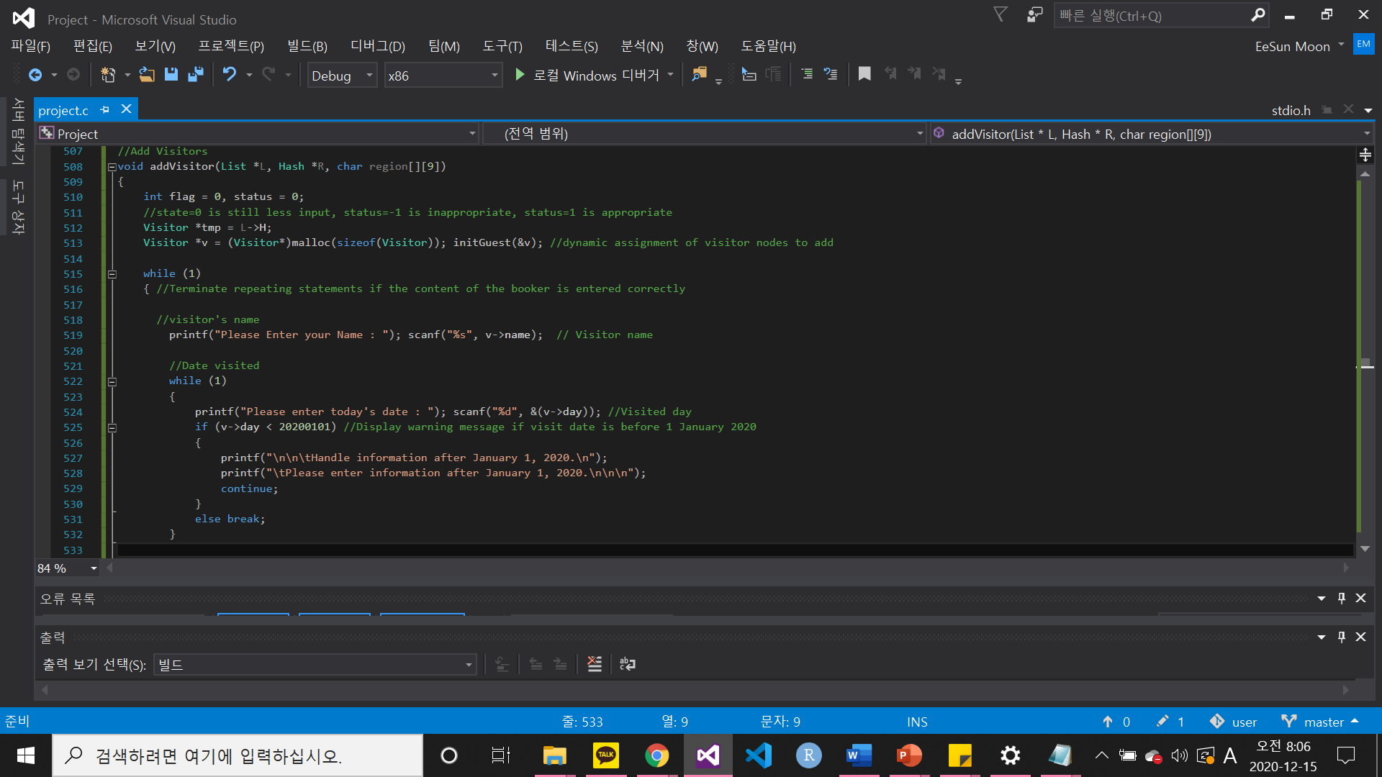
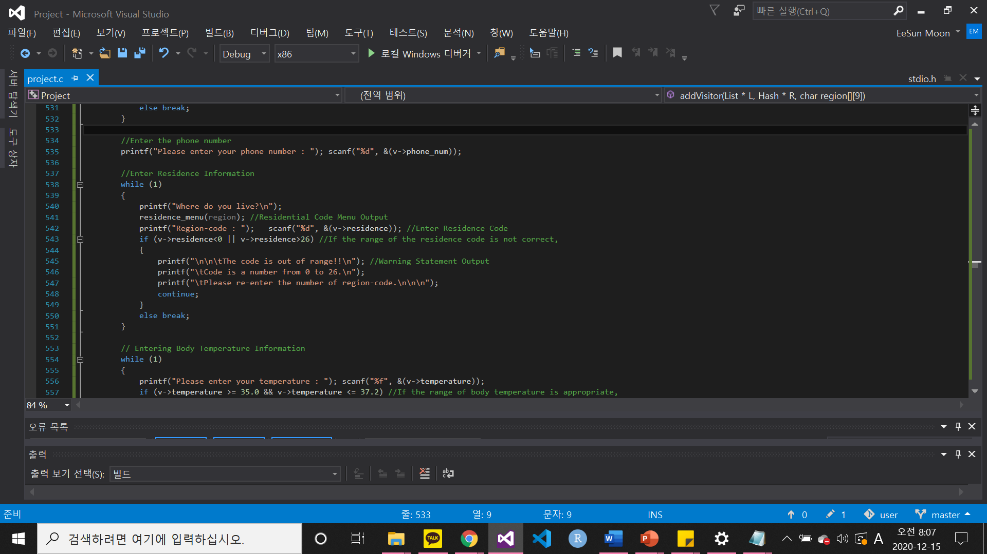
3. C-Code : Registration(Add)
REGISTRATION(ADD)
Name : can duplicated
Date>=20200101
0<=region code<=26
35<=temperature<=37.2
Oversea status : 1 (NO)
Personal info status : 1 (YES)
Name : can duplicated
Date>=20200101

Slide 30
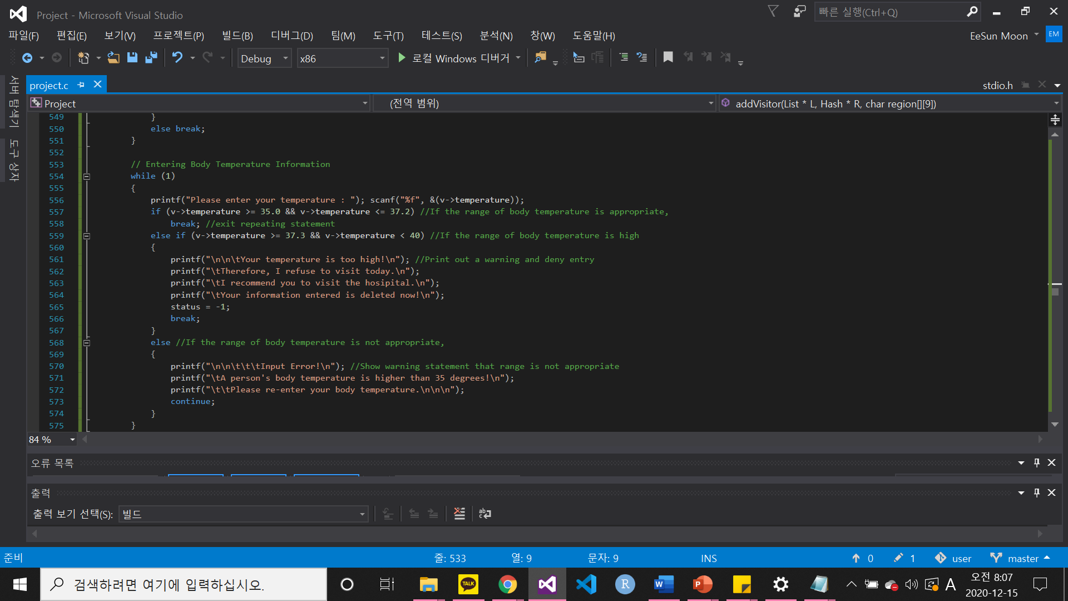
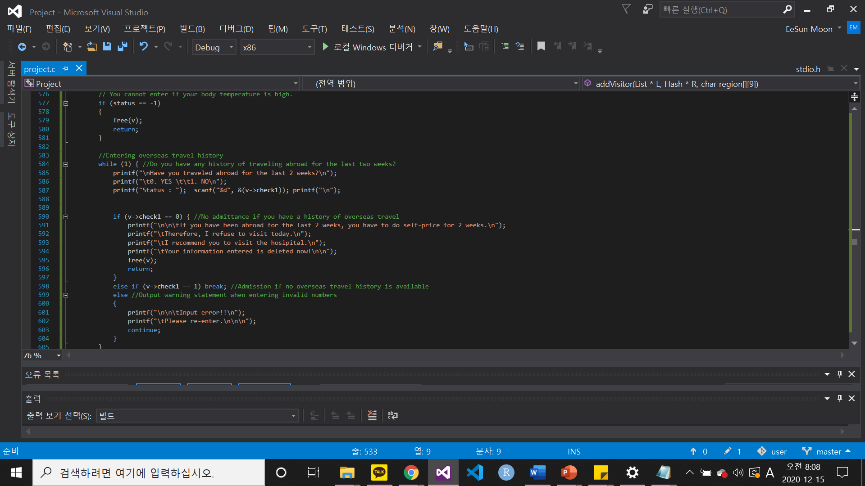
3. C-Code : Registration(Add)
REGISTRATION(ADD)
Name : can duplicated
Date>=20200101
0<=region code<=26
35<=temperature<=37.2
Oversea status : 1 (NO)
Personal info status : 1 (YES)
Name : can duplicated
Date>=20200101
0<=region code<=26
35<=temperature<=37.2

Slide 31
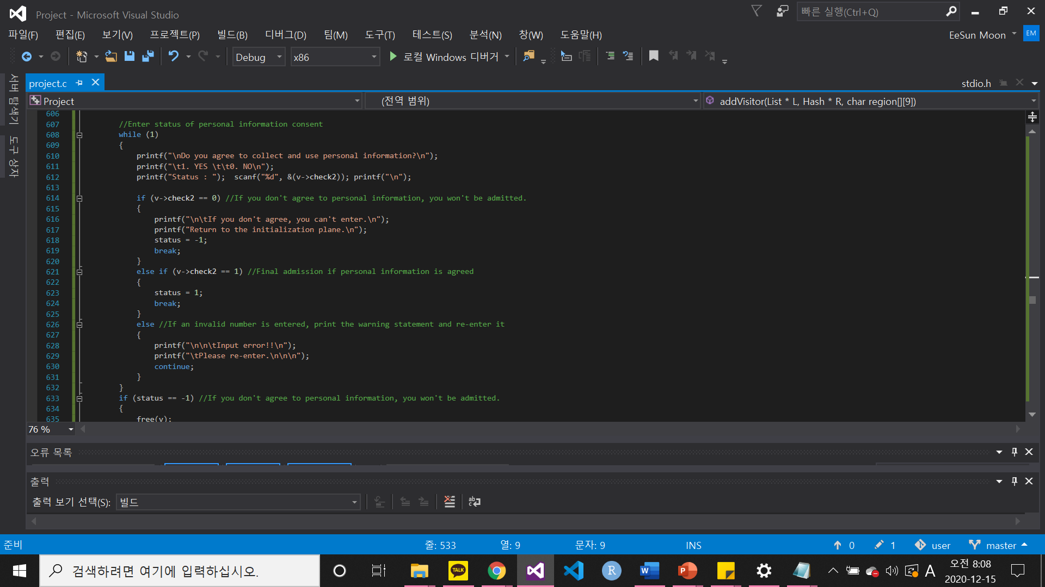

3. C-Code : Registration(Add)
REGISTRATION(ADD)
Name : can duplicated
Date>=20200101
0<=region code<=26
35<=temperature<=37.2
Oversea status : 1 (NO)
Personal info status : 1 (YES)
Name : can duplicated
Date>=20200101
0<=region code<=26
35<=temperature<=37.2
Oversea status : 1 (NO)
Personal info status : 1 (YES)

Slide 32

3. C-Code : Registration(Add)
Add to Visitor List
Add to HashTable - residence
REGISTRATION(ADD)
Name : can duplicated
Date>=20200101
0<=region code<=26
35<=temperature<=37.2
Oversea status : 1 (NO)
Personal info status : 1 (YES)
Name : can duplicated
Date>=20200101
0<=region code<=26
35<=temperature<=37.2
Oversea status : 1 (NO)
Personal info status : 1 (YES)

Slide 33
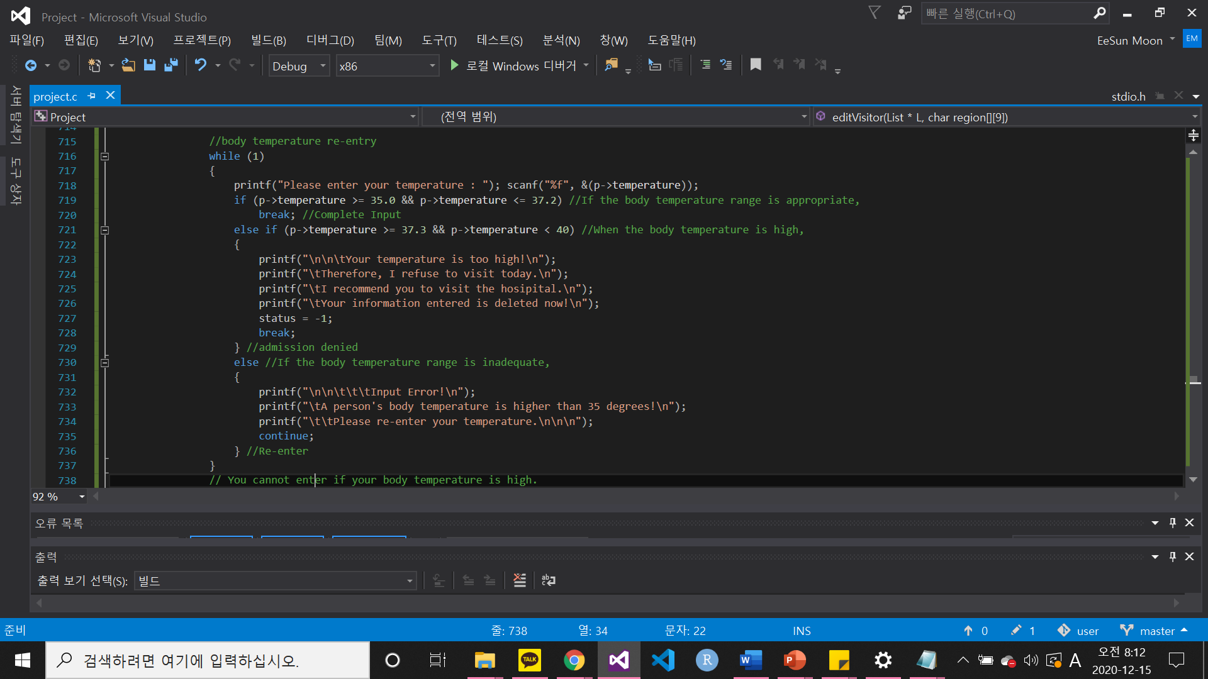
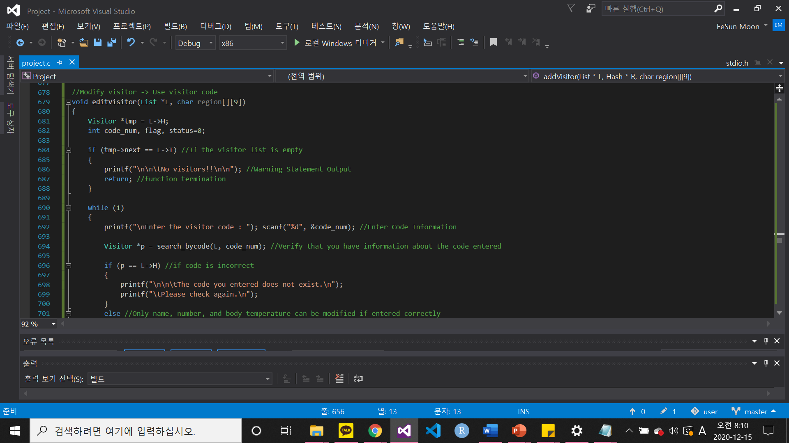
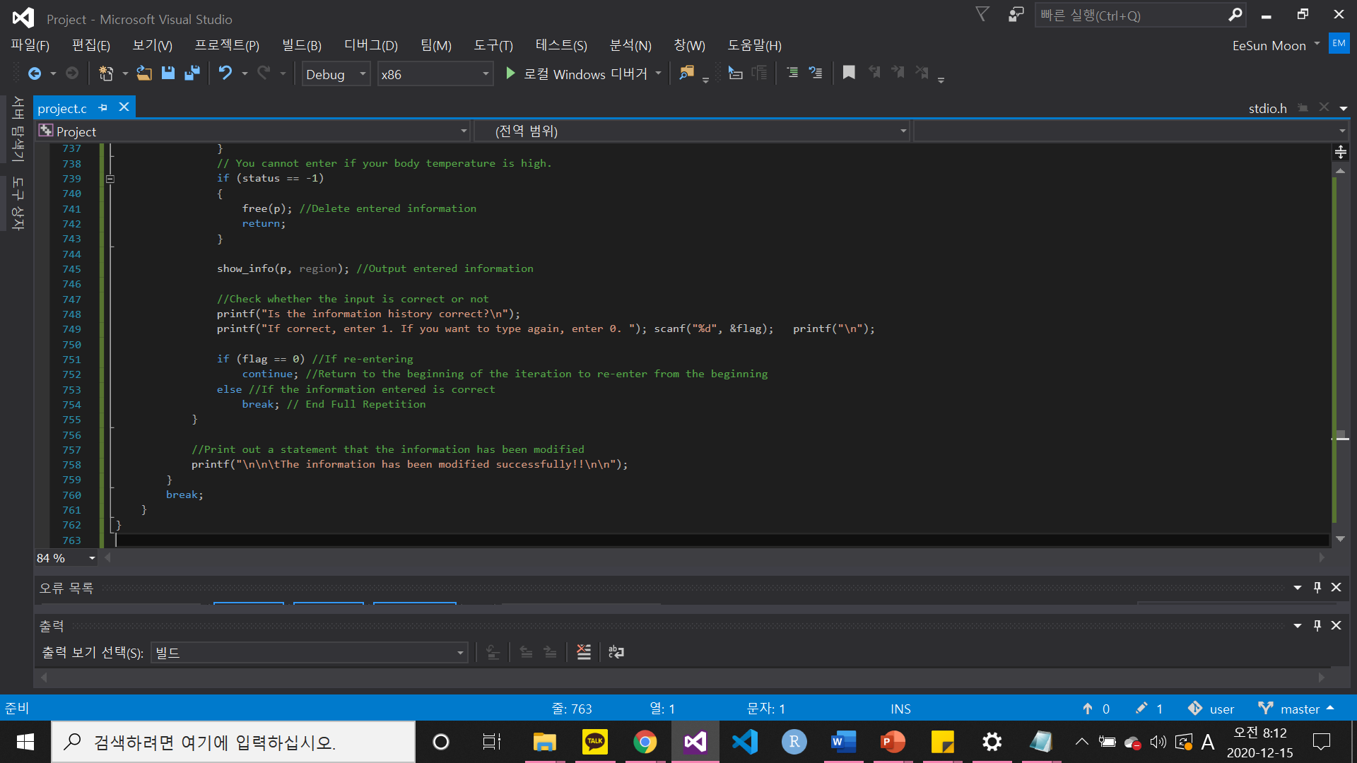
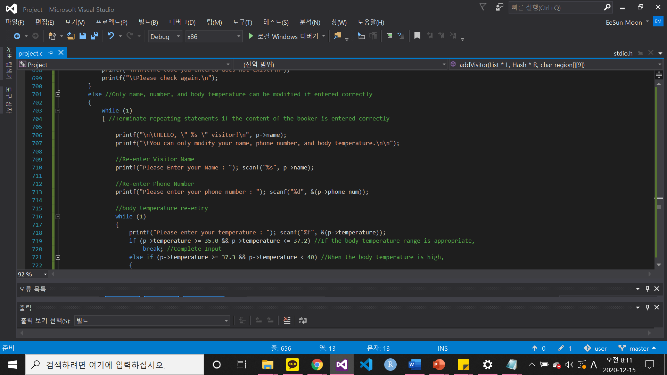
3. C-Code : Modification
MODIFICATION
self-certification with visitor code
self-certification with visitor code
ONLY
visitor’s name,
phone number
Body temperature
can be modified.
visitor’s name,
phone number
Body temperature

Slide 34
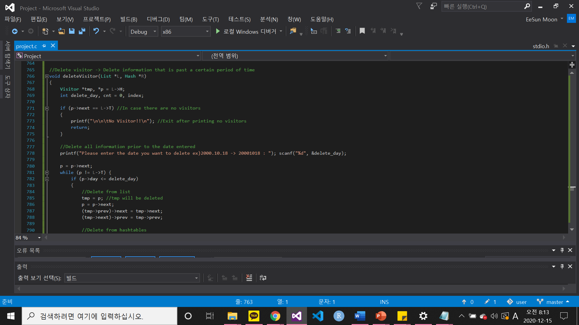
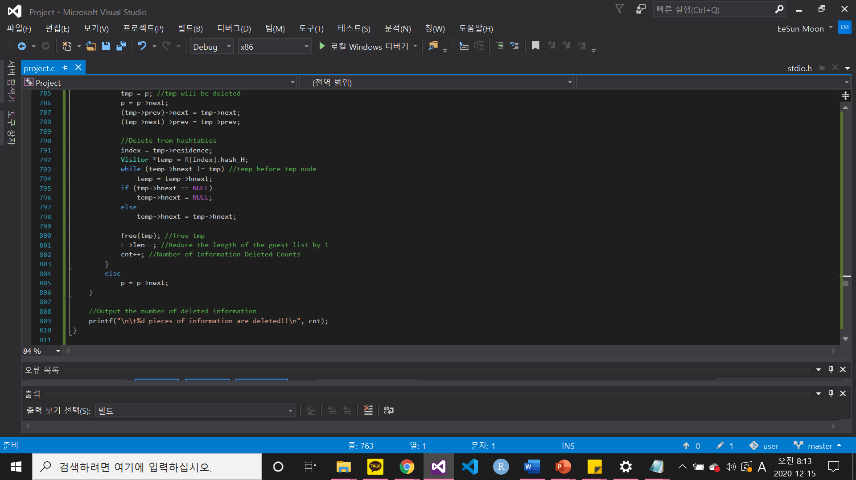
3. C-Code : Delete
Delete from list
Delete from hashtable
DELETE
Delete all data
prior to the date entered
Delete all data
prior to the date entered

Slide 35
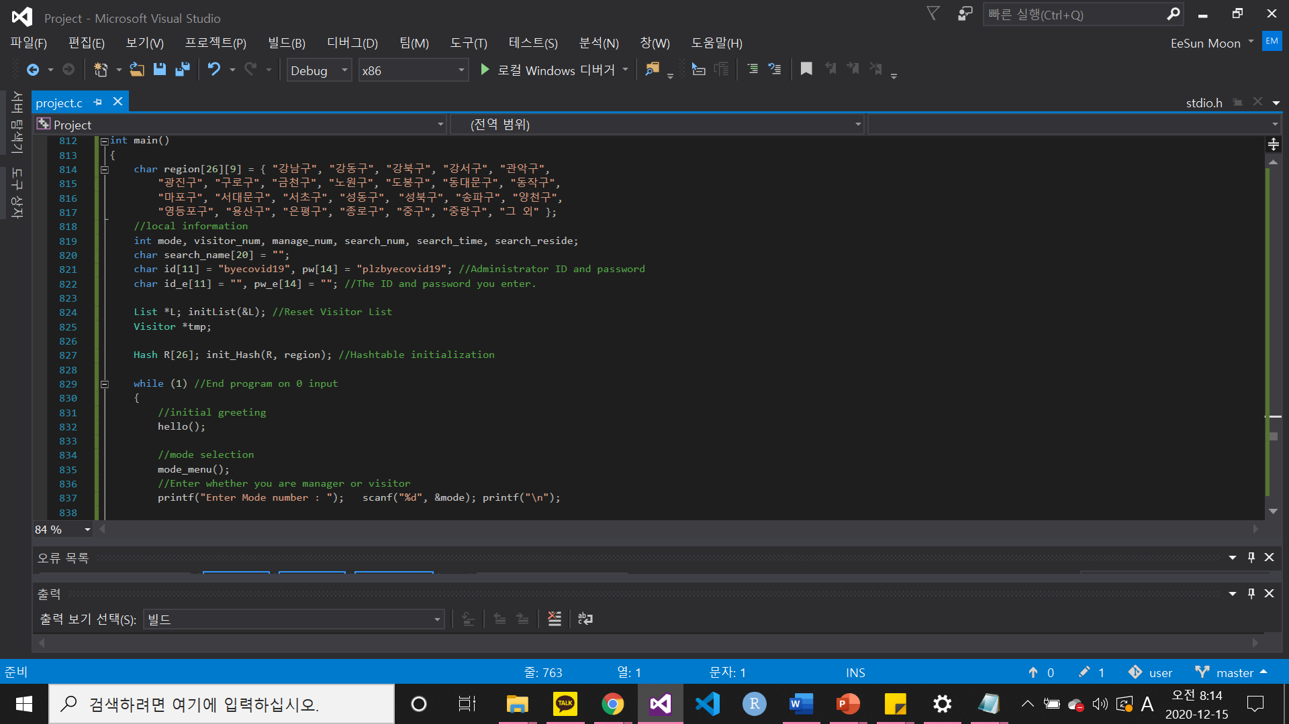

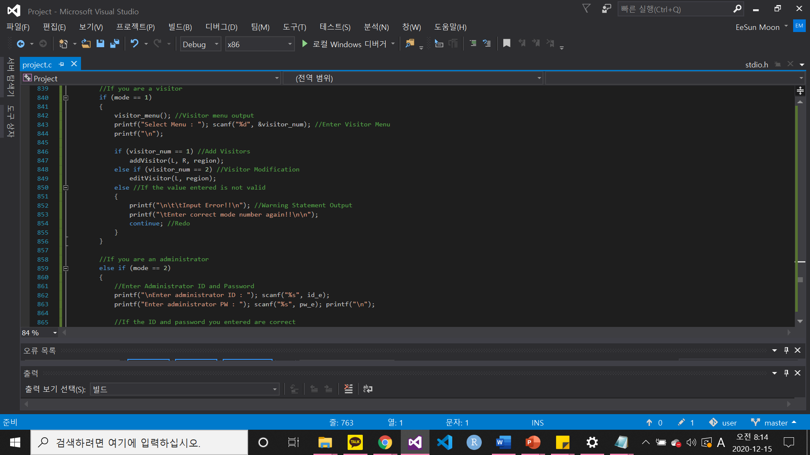

3. C-Code : Main Function
Main
Visitor
Manager
Visitor
Registration
Modification

Slide 36


3. C-Code : Main Function
Registration
Modification
Delete
Print all data
Print specific data
Log-out
Main
Visitor
Manager
Visitor
Manager

Slide 37
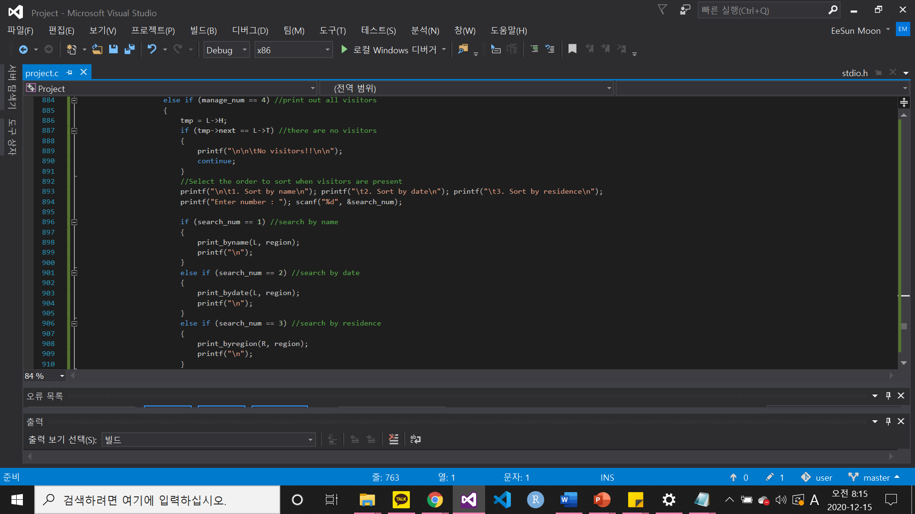
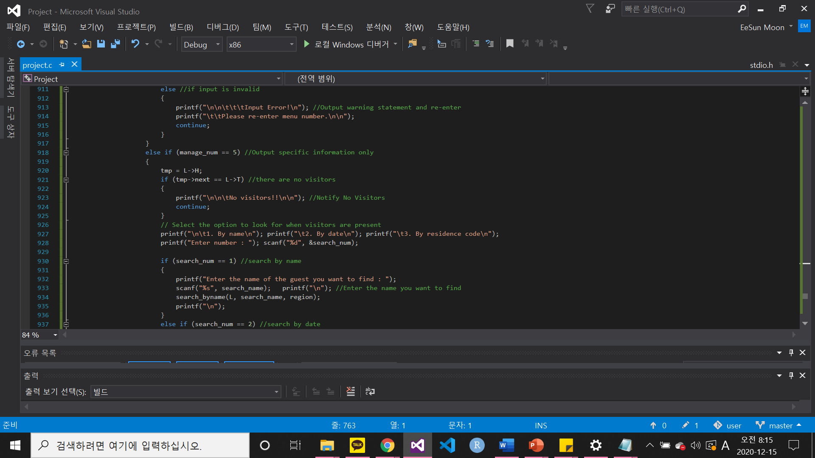
3. C-Code : Main Function
Registration
Modification
Delete
Print all data
Print specific data
Log-out
4-1) Print by name
4-2) Print by date
4-3) Print by residence
Main
Visitor
Manager
Visitor
Manager

Slide 38
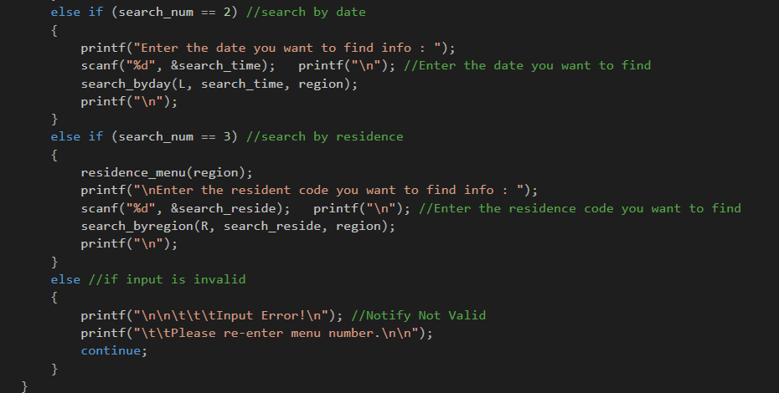
3. C-Code : Main Function
Registration
Modification
Delete
Print all data
Print specific data
Log-out
4-1) Search by name
4-2) Search by date
4-3) Search by residence
Main
Visitor
Manager

Slide 39

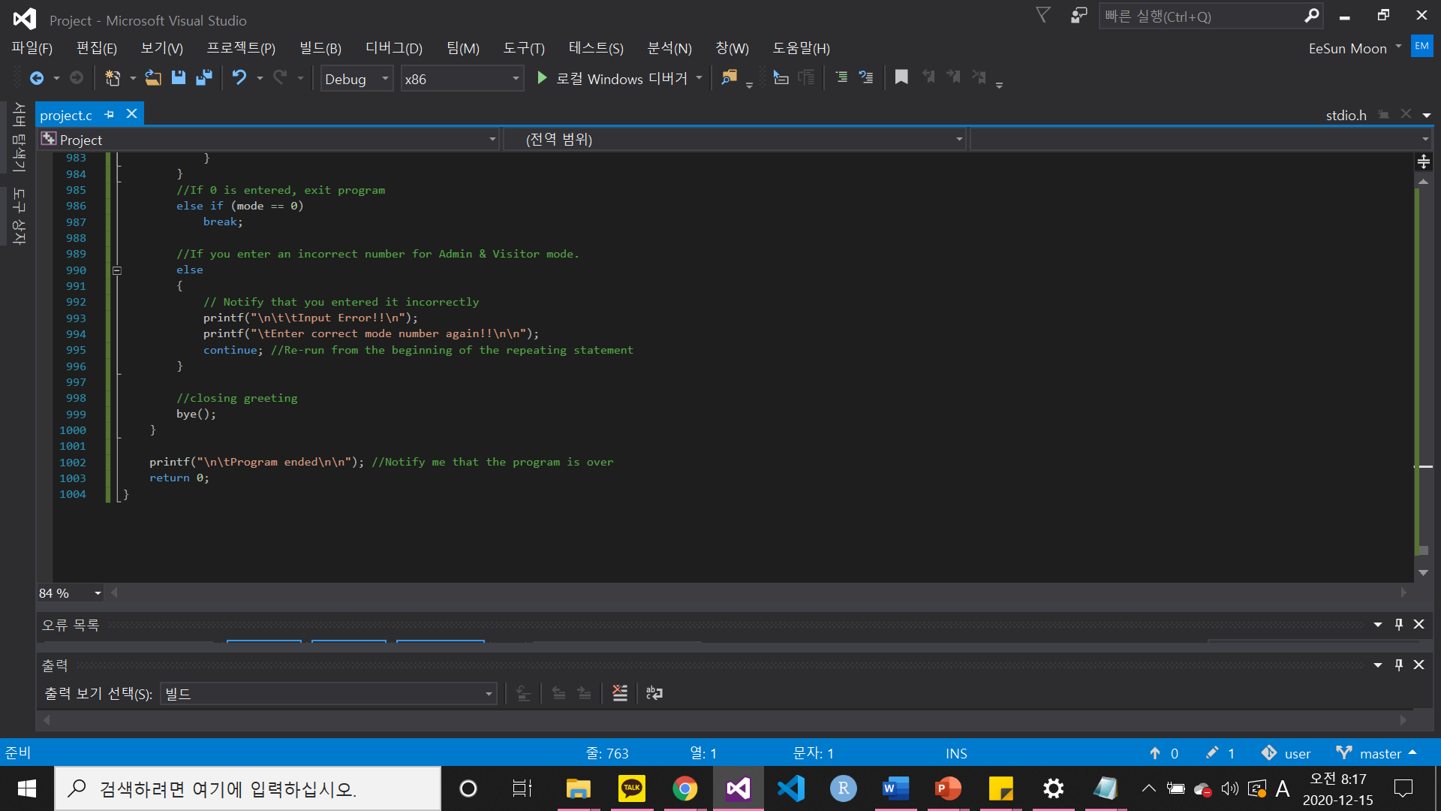
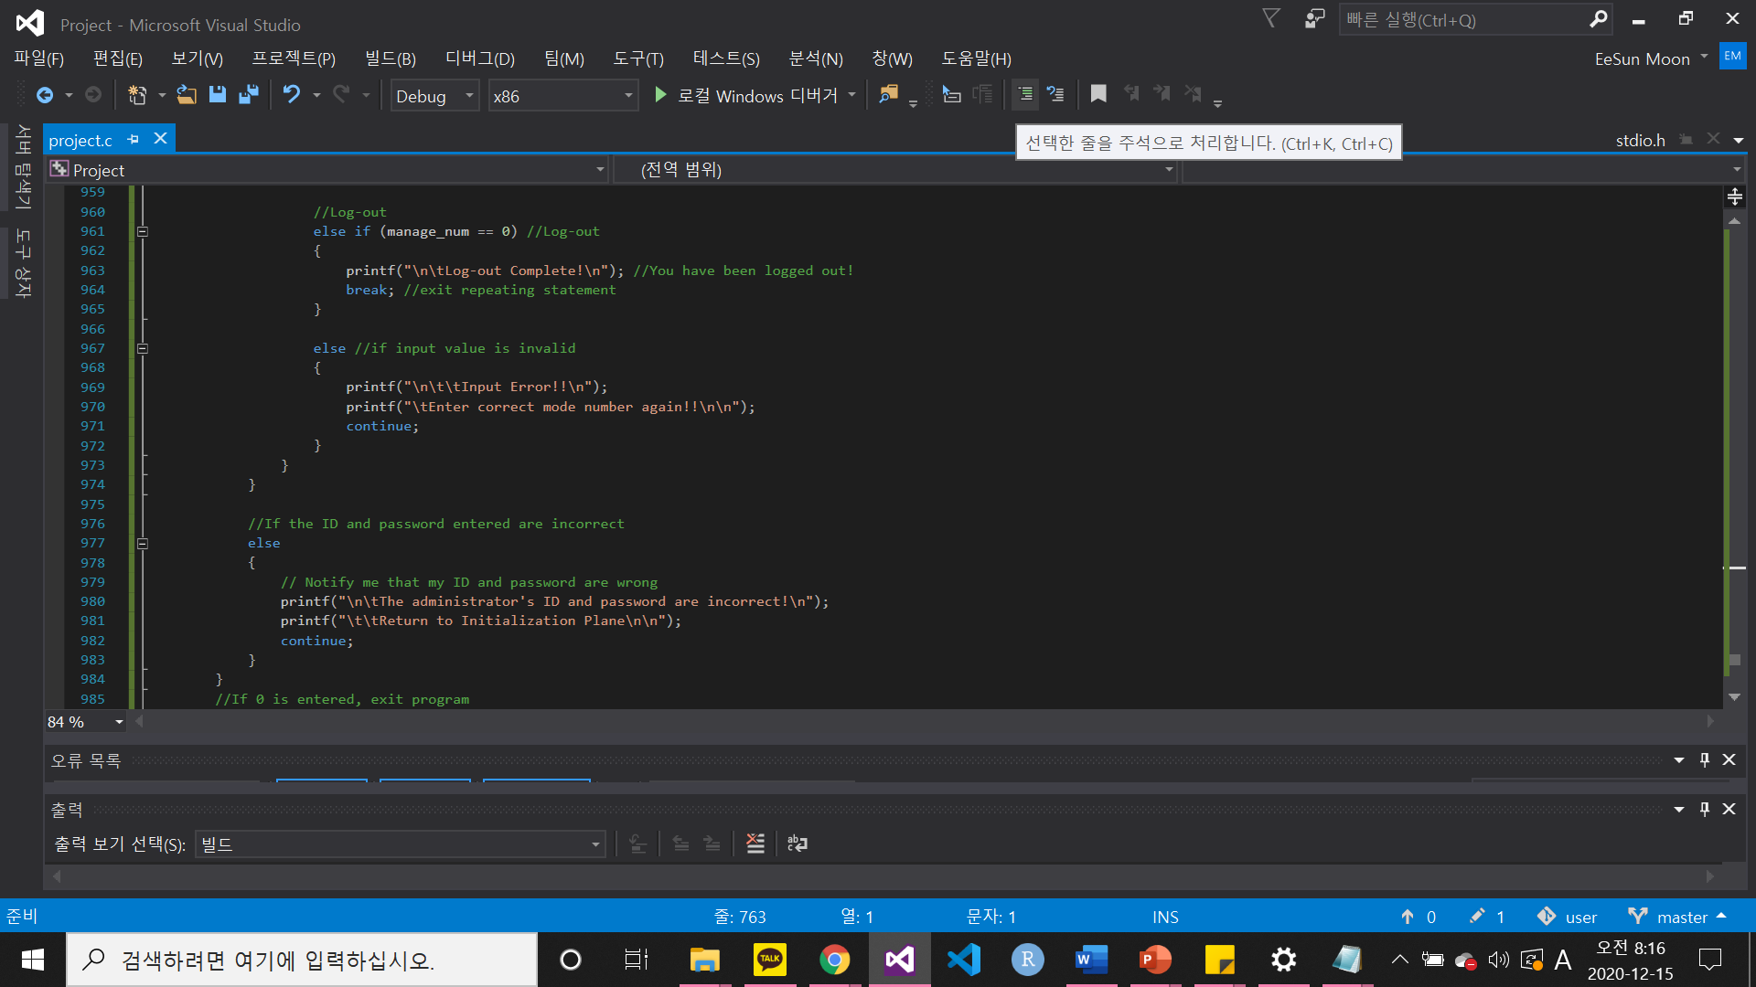
3. C-Code : Main Function
Registration
Modification
Delete
Print all data
Print specific data
Log-out
Main
Visitor
Manager
Visitor
Manager

Slide 40
3. C-Code
1. Introduction
2. About code
3. C-Code
4. Conclusion
4. Conclusion

Slide 41
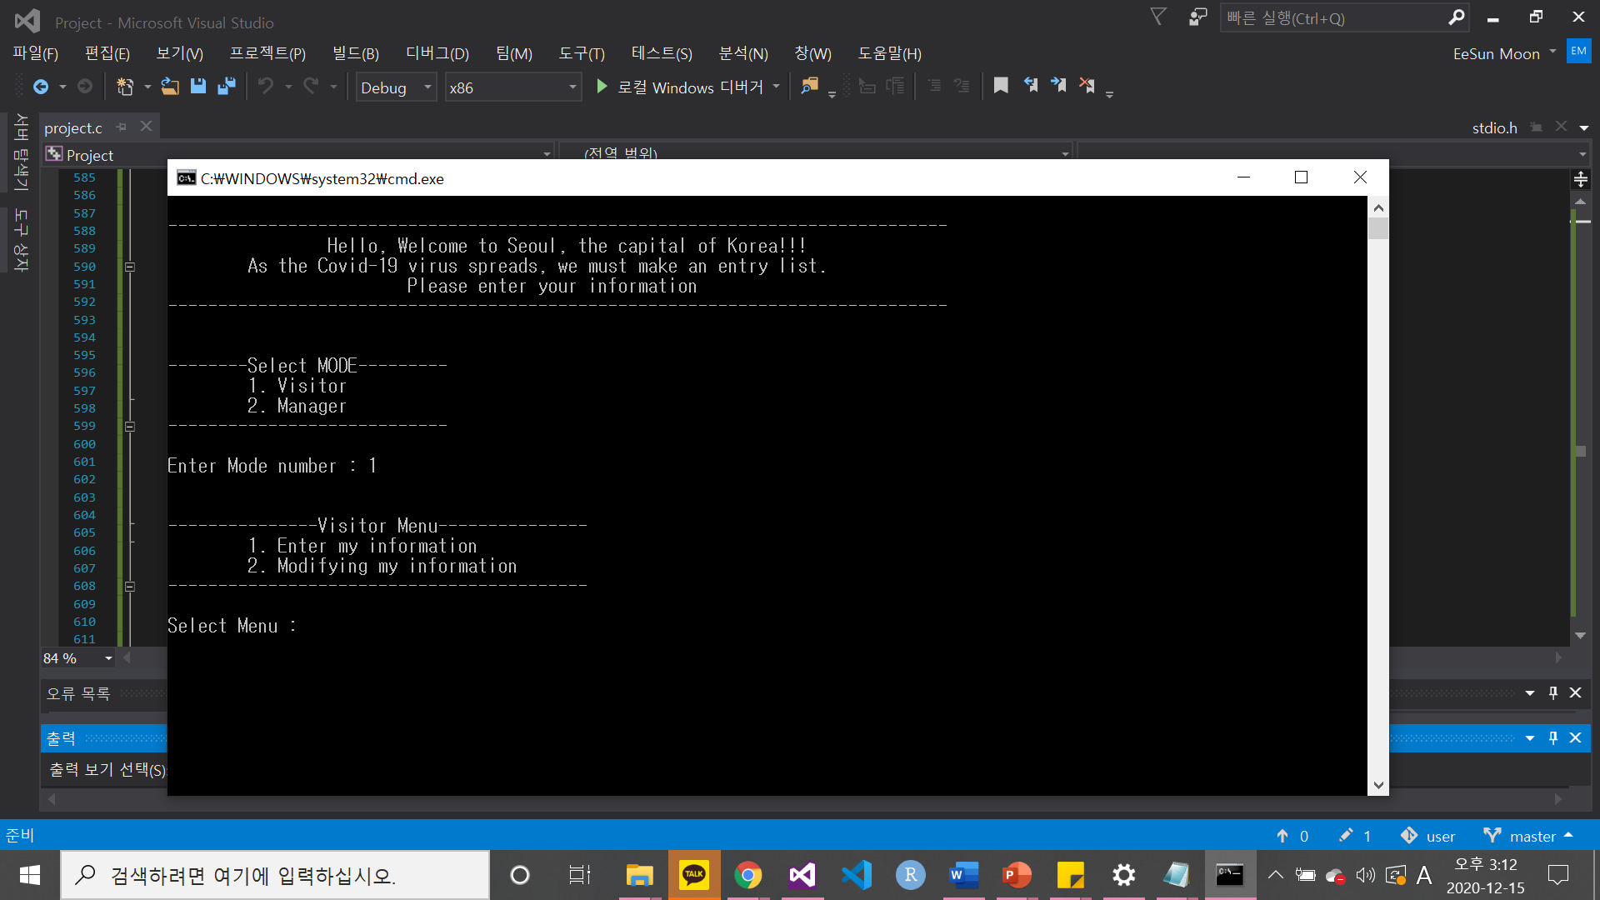




4. Conclusion
1 INPUT : Visitor
<<Start>>
Entering information and modifying information
while in visitor mode
Log-in screen
ID &PW incorrect
2 INPUT : Manager
ID &PW correct
Notes:
추가와 수정은 visitor모드와 manager 모드일 때 다 같음
추가에 관련된 것은 뒷장에서

Slide 42


4. Conclusion
1. Registration(ADD) - correct
Visited date(20200103)>=20200101 : OK
0<=Region code(0) <= 25 : OK
35<= temperature(36.5) <= 37.2 : OK

Slide 43

4. Conclusion
1. Registration(ADD) - correct
abroad status(1) == 1 (NO) : OK
personal info status(1) == 1 (YES) : OK
correct status(1) == 1 (YES) : OK
Registration completed!

Slide 44




4. Conclusion
1. Registration(ADD) - incorrect
Visited date(20190101) < 20200101 : INVALID
35 > temperature(34) : INVALID
37.3 < temperature(38) : CANNOT VISIT
Region code(30) > 26 : INVALID

Slide 45


4. Conclusion
1. Registration(ADD) - incorrect
abroad status(0) != 1 (NO) : CANNOT VISIT
personal info status(0) != 1 (YES) : CANNOT VISIT
Registration deny!

Slide 46




4. Conclusion
2. Modification - correct
Mike’s visitor code is 24891
Check that the modification
was successful
Only name, phone number, temperature are modified.

Slide 47


4. Conclusion
2. Modification – an unmodified situation
CASE 1 : There is no information
in the code entered
CASE 2 : There is no information
in the code entered

Slide 48




4. Conclusion
3. Delete
CASE 1 : No data was saved prior to the date entered
CASE 2 : There is data stored before the date entered
Check that the modification
was successful
CASE 3 : There is no data to delete

Slide 49




4. Conclusion
4. Print all data
Sort by name : merge sort
Sort by visited date : merge sort
Sort by residence code : Hash table
<<Visitor Data>>
Name : es
Date : 20201018
Phonenum : 12
Residence : 0
Temperature : 35
Check1 : 1
Check2 : 1
Name : es
Date : 20200320
Phonenum : 10
Residence : 4
Temperature : 36
Check1 : 1
Check2 : 1
Name : bj
Date : 20201230
Phonenum : 23
Residence : 5
Temperature : 36.4
Check1 : 1
Check2 : 1
List
*prev | Visitor’s information (name, code, day, phone_num, residence, temperature) | *next
 | *hnext
Visitor
Name : ah
Date : 20201123
Phonenum : 9
Residence : 17
Temperature : 37
Check1 : 1
Check2 : 1
Name : sj
Date : 20201123
Phonenum : 43
Residence : 0
Temperature : 35
Check1 : 1
Check2 : 1
Name : ck
Date : 20200130
Phonenum : 7
Residence : 0
Temperature : 36
Check1 : 1
Check2 : 1
Hash Table

Slide 50


4. Conclusion
Sort by name complete!
4. Print all data – Sort by name

Slide 51


4. Conclusion
Sort by visited date complete!
4. Print all data – Sort by visited date

Slide 52



4. Conclusion
4. Print all data – Sort by residence code
1
4
2
5
3

Slide 53



4. Conclusion
Sort by residence complete!
4. Print all data – Sort by residence code
6
There are six visitors!

Slide 54


4. Conclusion
5. Print specific data – Print by name
CASE 2 : If the visitors' names duplicated
Search_name : es
CASE 1 : If the visitors' names do not duplicated
Search_name : bj

Slide 55


4. Conclusion
5. Print specific data – Print by visited date
CASE 2 : If the visited date duplicated
Search_date : 20201123
CASE 1 : If the visited date doesn’t duplicated
Search_date : 20201018

Slide 56



4. Conclusion
CASE 3 : If there are multiple visitors living in the region entered
Search region : 0(강남구)
5. Print specific data – Print by residence
CASE 1 : If no visitors live in the entered region
Search region : 1(강동구)
CASE 2 : If there is only one visitor living in the region entered
Search region : 17(송파구)

Slide 57
4. Conclusion
1. Introduction
2. About code
3. C-Code
4. Conclusion
4. Conclusion

Slide 58
19011773 Moon EeSun
Thank you

